Slide 1
Productions of second Kaluza-Klein gauge bosons in the minimal universal extra dimension model at LHC
Masato Yamanaka (Tokyo university, ICRR) Collaborators Shigeki Matsumoto Joe Sato Masato Senami
PHYSICAL REVIEW D 80, 056006 (2009)

Slide 2
Introduction
Universal Extra Dimension (UED) model
Model discrimination at LHC
Motivation

Slide 3
Minimal Universal Extra Dimension (MUED) model
[ Appelquist, Cheng, Dobrescu PRD67 (2000) ]
(time 1 + space 4)
5-dimensions
1
S /Z orbifolding
2
R
1
S
4D spacetime
All SM particles propagate in spatial extra dimension
New parameters in UED models
R : compactification scale of extra dimension
Λ : cutoff scale of UED model

Slide 4
Minimal Universal Extra Dimension (MUED) model
[ Appelquist, Cheng, Dobrescu PRD67 (2000) ]
(time 1 + space 4)
5-dimensions
1
S /Z orbifolding
2
R
1
S
4D spacetime
All SM particles propagate in spatial extra dimension
Many Kaluza-Klein (KK) particles for one SM particle
Φ
(0)
Φ
(1)
Φ
(2)
Φ
(n)
, , …… ,
SM particle
KK particle
Mass spectrum 1/R, 2/R, …..…, n/R

Slide 5
Model discrimination at LHC
proton
proton
g
Missing energy
(1)
q
γ
(1)
(1)
(1)
(1)
Z
l
MUED collider event
q
q
l
l

Slide 6
Model discrimination at LHC
proton
proton
g
Missing energy
(1)
q
γ
(1)
(1)
(1)
(1)
Z
l
MUED collider event
q
q
l
l
proton
proton
~
Missing energy
g
~
~
~
~
q
Z
l
γ
SUSY collider event
q
q
l
l
Quite similar and difficult to discriminate !

Slide 7
Model discrimination at LHC
～
Φ
Φ
SUSY
SM particle
Supersymmetric particle
Φ
Φ
(1)
Φ
(2)
Φ
(n)
MUED
, , …… ,
SM particle
KK particle

Slide 8
Model discrimination at LHC
～
Φ
Φ
SUSY
SM particle
Supersymmetric particle
Φ
Φ
(1)
Φ
(2)
Φ
(n)
MUED
, , …… ,
SM particle
KK particle
(0)
f
(2)
Second KK particle can couple with SM particles directly
V
(0)
[ Cheng, Matchev, Schmaltz PRD66 (2002) ]
f
[ Datta, Kong, Matchev PRD72 (2005) ]
Second KK photon (Z boson) decay into dilepton
Mass reconstruction from dilepton clean signal

Slide 9
Motivation
γ
(2)
(2)
Z
Precise calculation of production rate of and
Connecting our prediction to LHC data
Discrimination between models and confirmation UED

Slide 10
γ
(2)
and production
Z
(2)
KK number violating operator
Production process

Slide 11
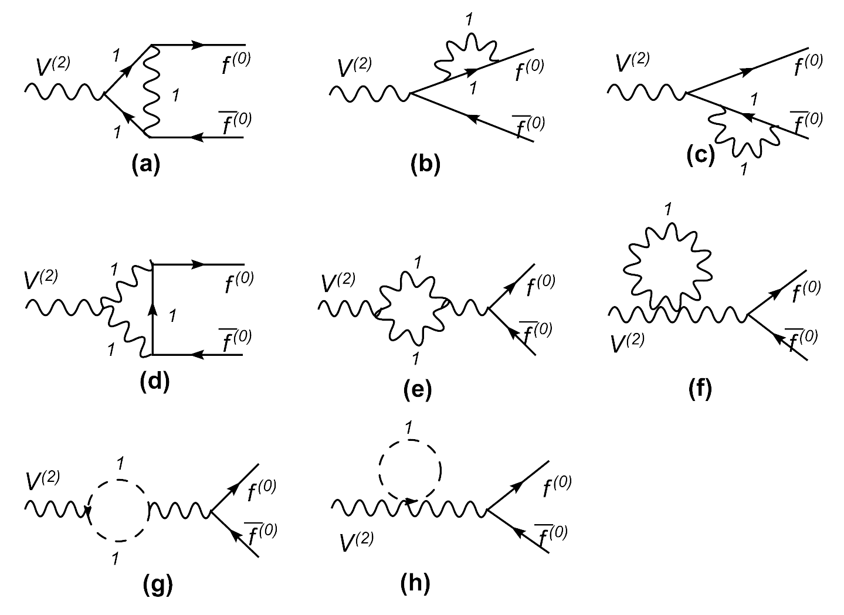
KK number violating operator
(0)
f
(2)
V
(0)
f
KK number violating vertices (gauge interaction)
All loop diagrams
KK number violating vertices (Yukawa interaction)

Slide 12
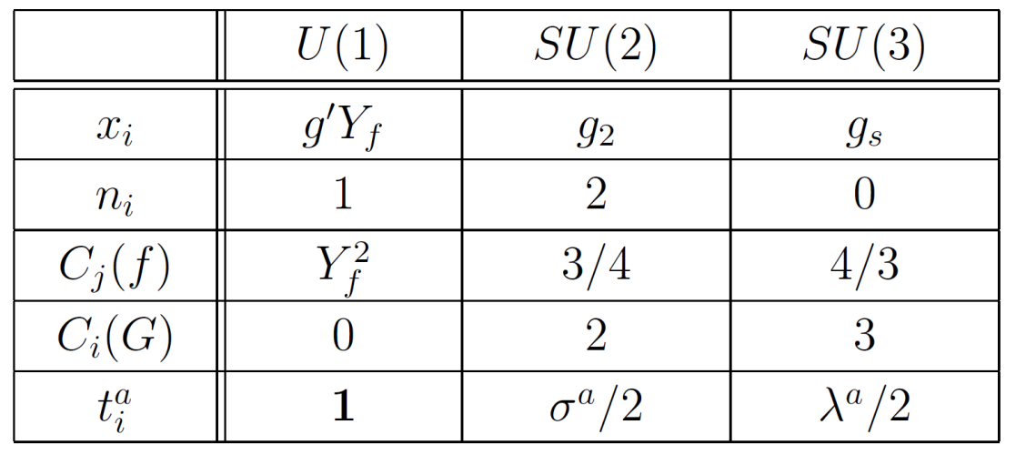
(0)
f
(2)
KK number violating operator
V
(0)
f

Slide 13
(0)
f
(2)
KK number violating operator
V
(0)
f
Significant advantages of the operator
γ
(2)
(2)
Clean mass reconstruction of and Z
γ
Production of , Z without kinematic suppression
(2)
(2)

Slide 14
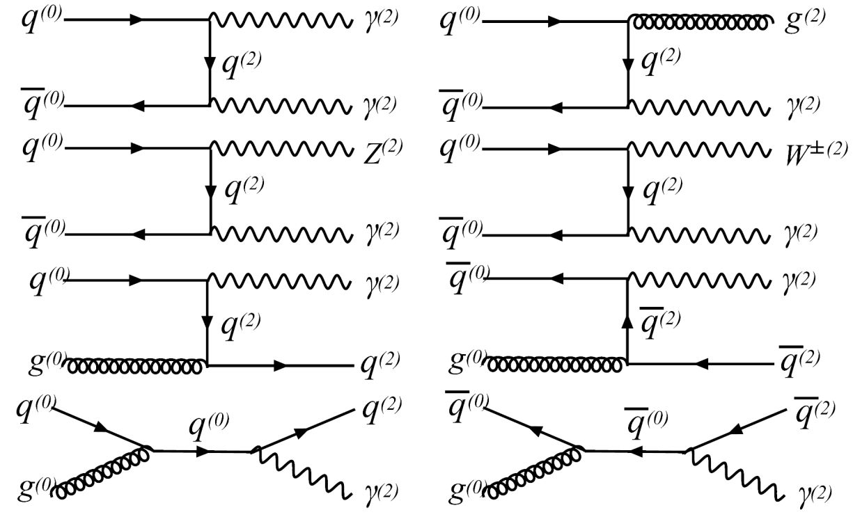
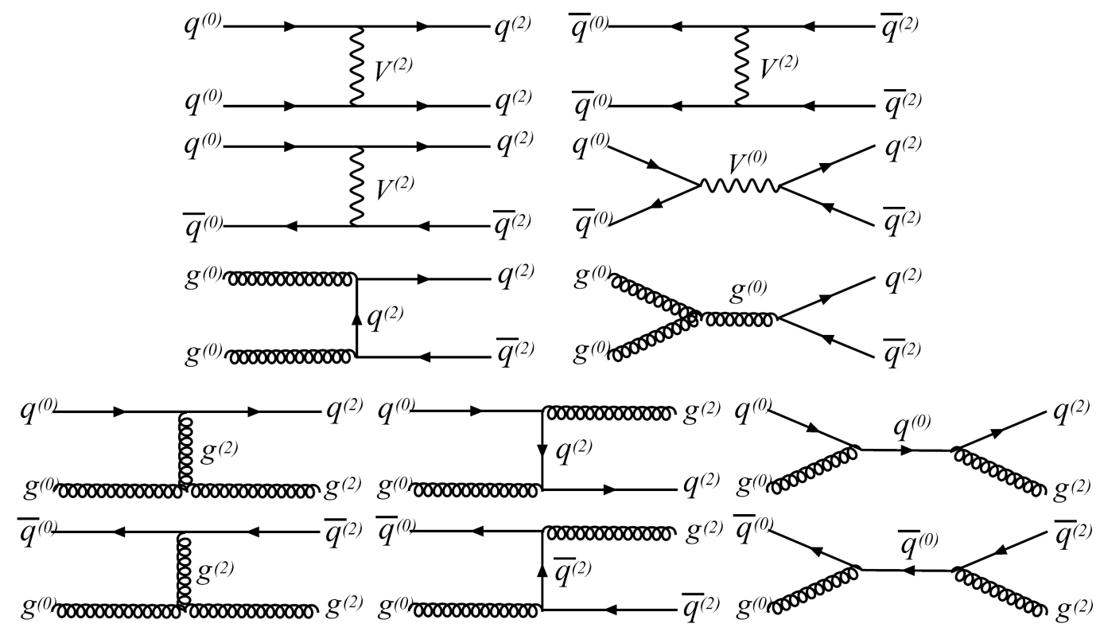
Production through the KK number conserving processes
Advantage
No loop suppression
・
Disadvantage
・
Kinematic suppression due to pair production of second KK particles

Slide 15
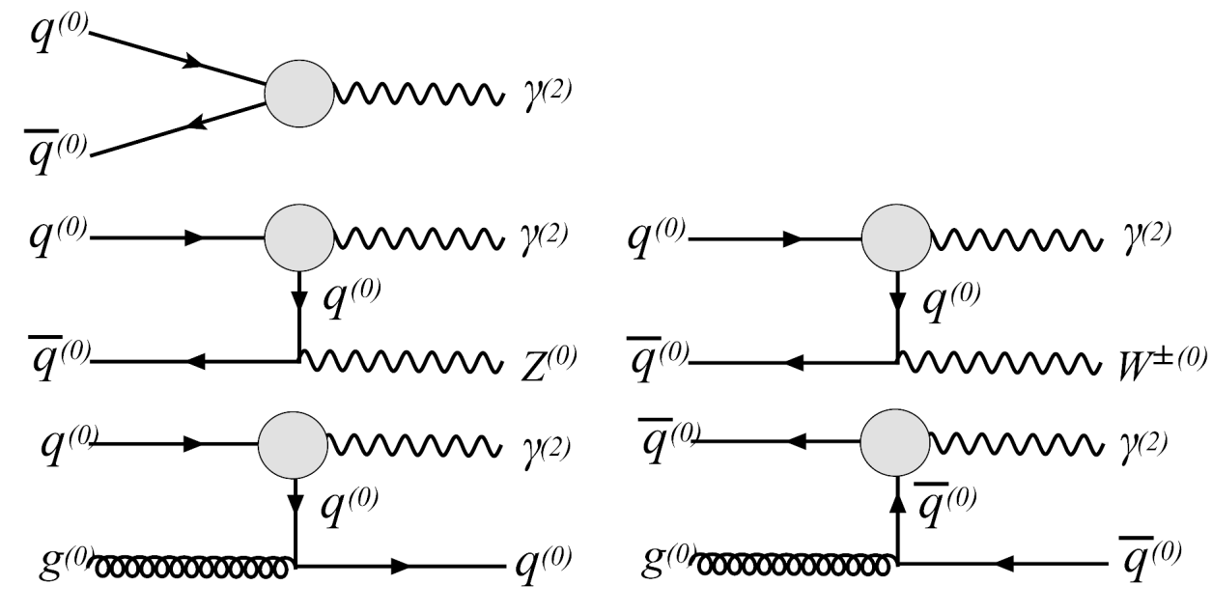
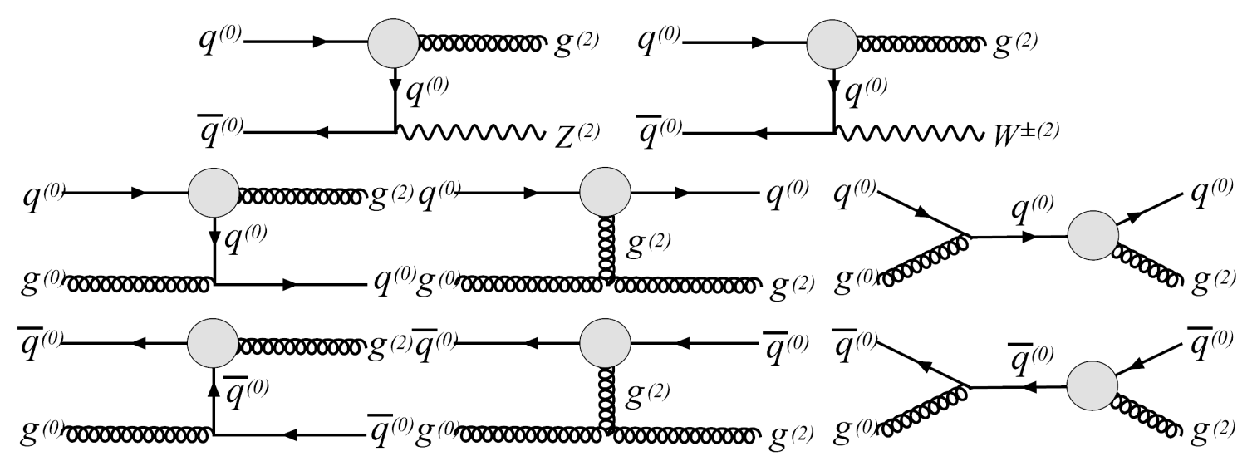
Production through the KK number violating processes
Advantage
Evading the phase space suppression
・
Disadvantage
・
Loop factor suppression

Slide 16
Numerical result

Slide 17
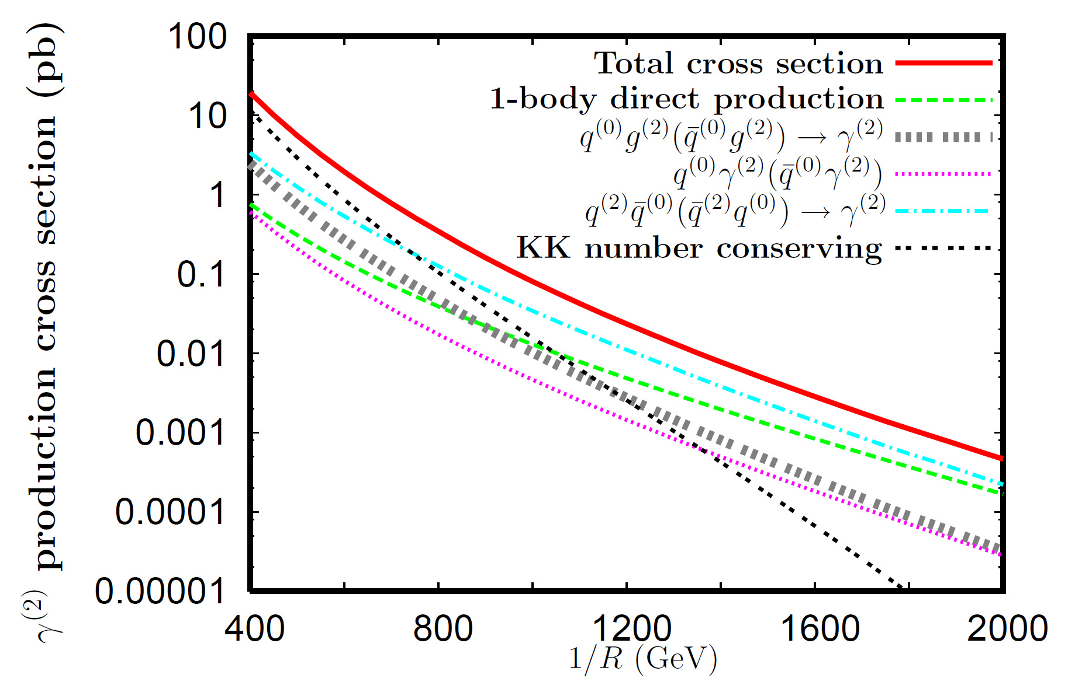
Total production rate
1
For integrated luminosity 100 fb
γ
6
2
(2)
10
10
production
( For 400 GeV – 2000 GeV )

Slide 18
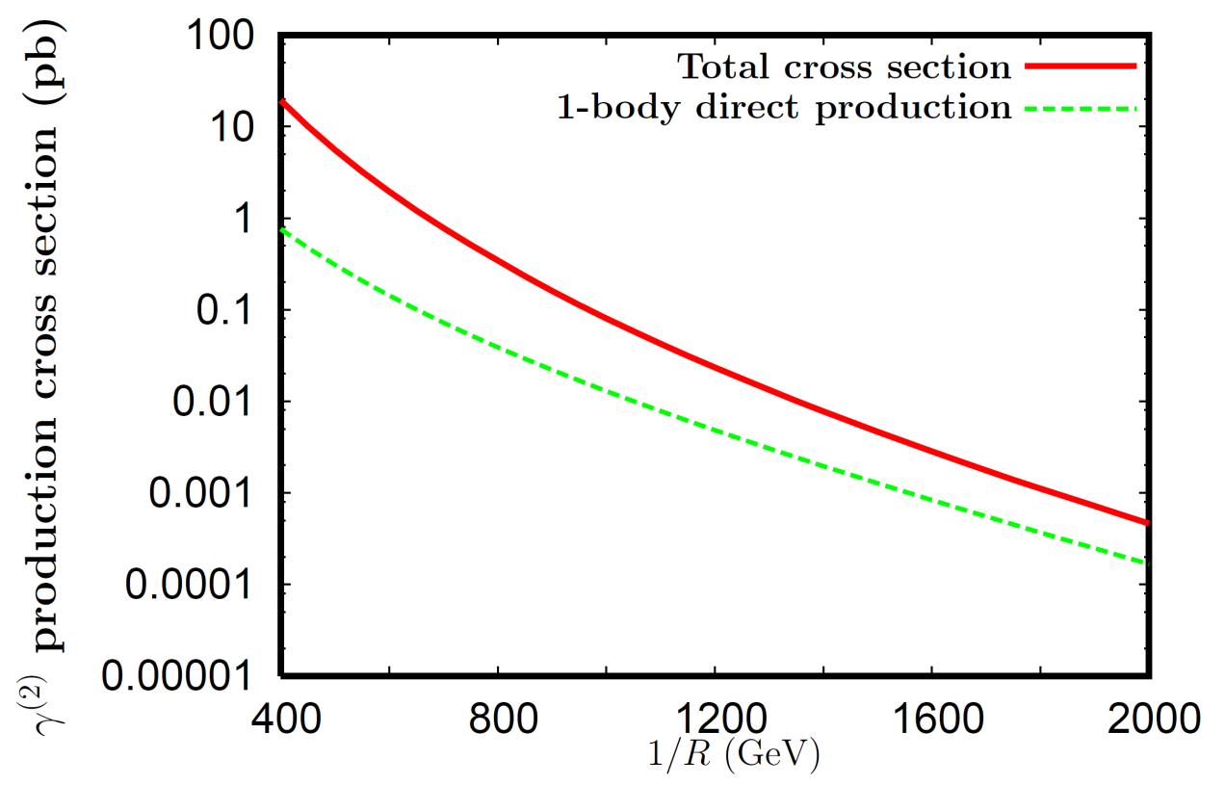
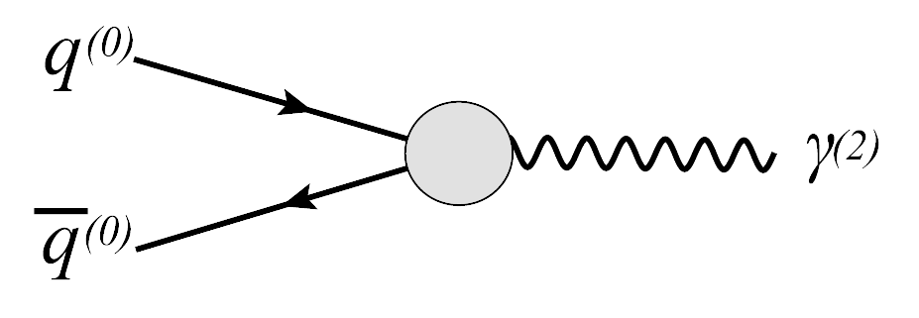
Discussion : significance of each process
(1) Without kinematic suppression
γ
(2)
(2)
(2) and are directly produced
Z
Large contribution to the total cross section, particularly for large 1/R

Slide 19
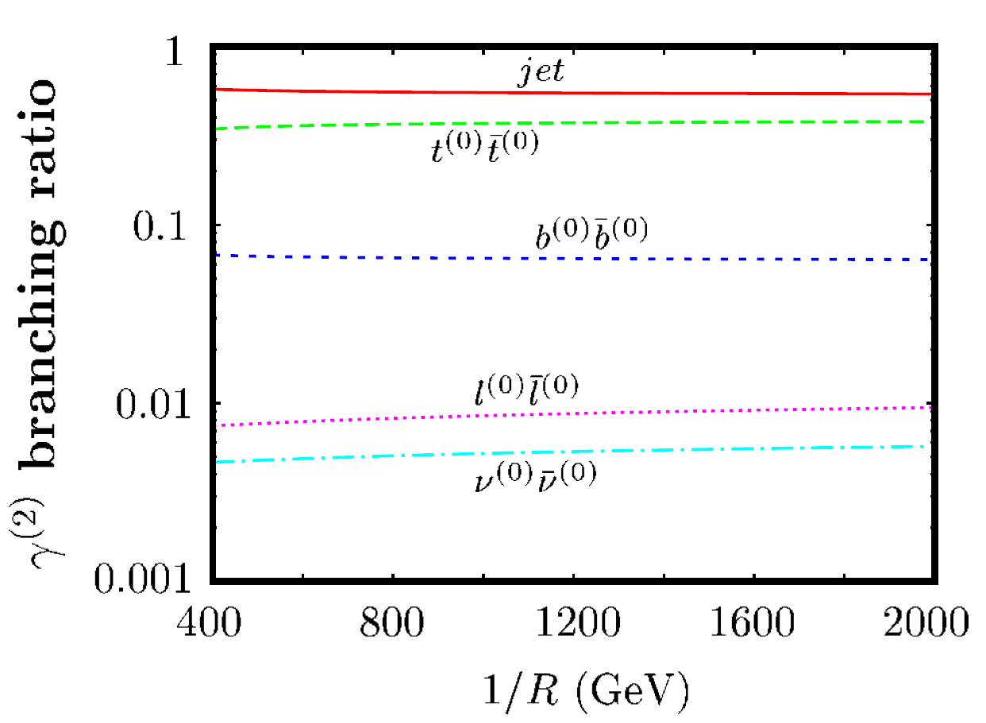
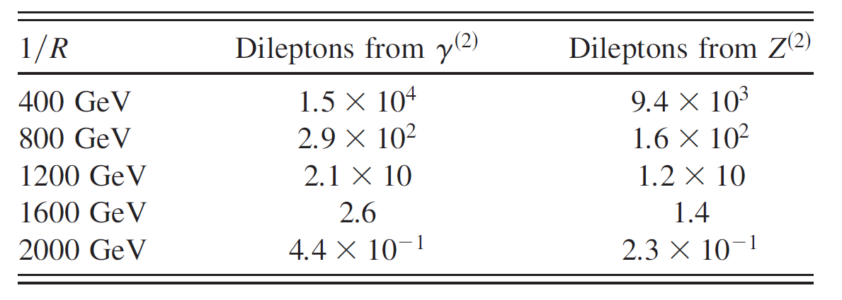
Dilepton signal
For integrated luminosity 100 fb
1

Slide 20
Summary
It can be difficult to discriminate MUED model from other models
(0)
γ
f
(2)
(2)
Z
and are the key ingredients for the discrimination
(2)
V
(0)
f
We calculated the KK number violating operator
γ
(2)
(2)
Z
We calculated the production rate of and
Our prediction make it possible to the model discrimination and confirmation of the MUED model

Slide 21
Appendix

Slide 22
Universal Extra Dimension (UED) model
[ Appelquist, Cheng, Dobrescu PRD67 (2000) ]
3 families from anomaly cancellation
[ Dobrescu, Poppitz PRL 68 (2001) ]
Preventing rapid proton decay from non-renormalizable operators
[ Appelquist, Dobrescu, Ponton, Yee PRL 87 (2001) ]
Existence of dark matter
[ Servant, Tait NPB 650 (2003) ]
Explaining cosmic ray excess anomaly
[ J. Chang et al. Nature 456 (2008) ]

Slide 23
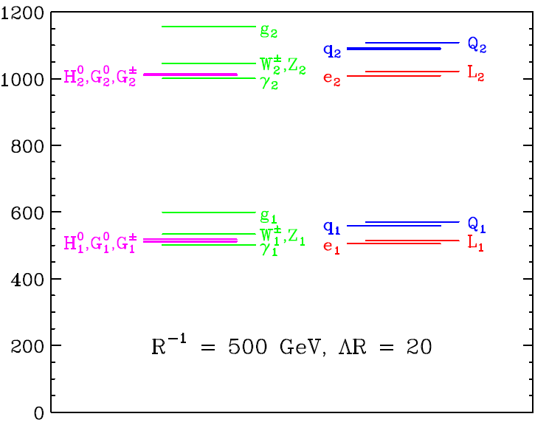
Example of mass spectrum
[ Datta, Kong, Matchev PRD72 (2005) ]

Slide 24
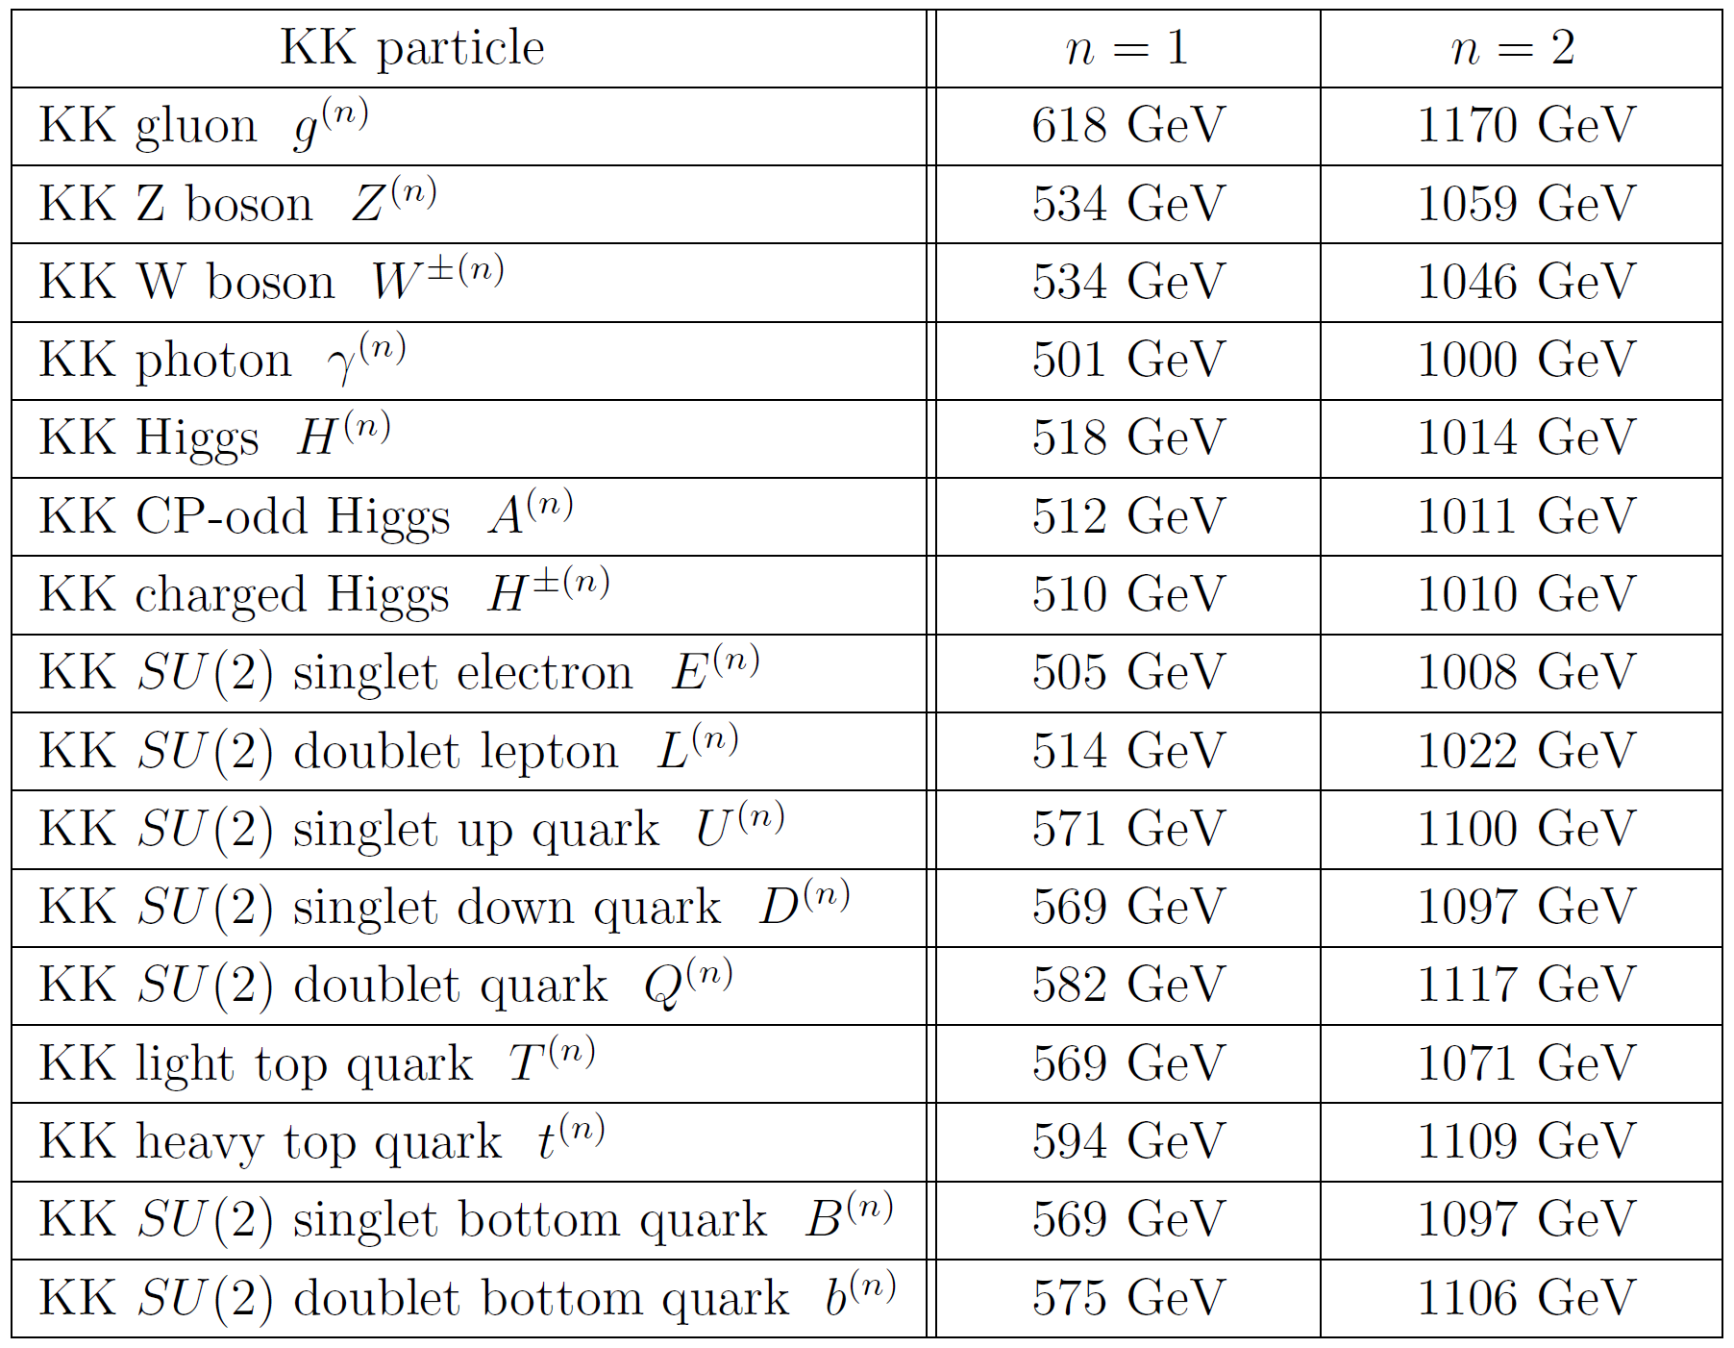

Slide 25
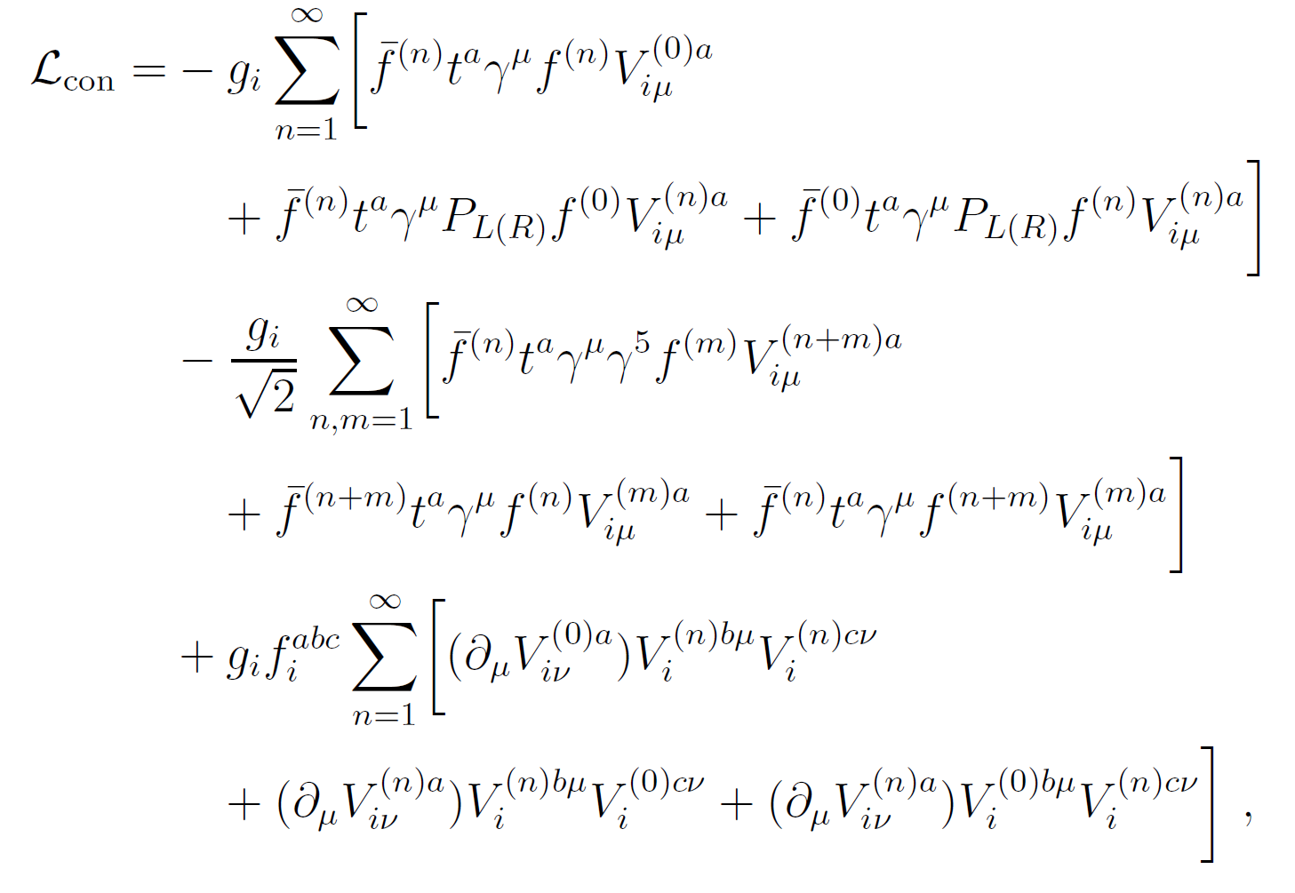
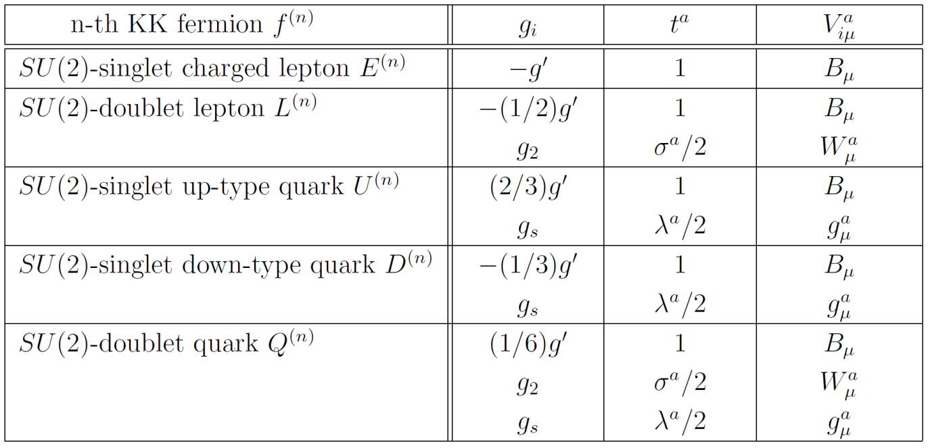

Slide 26
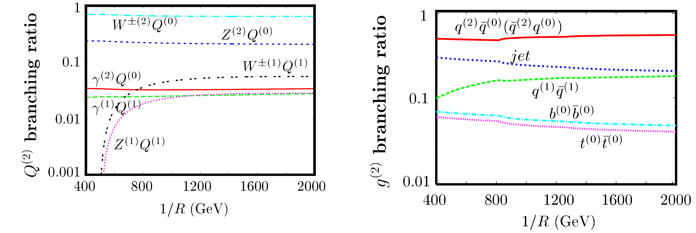

Slide 27
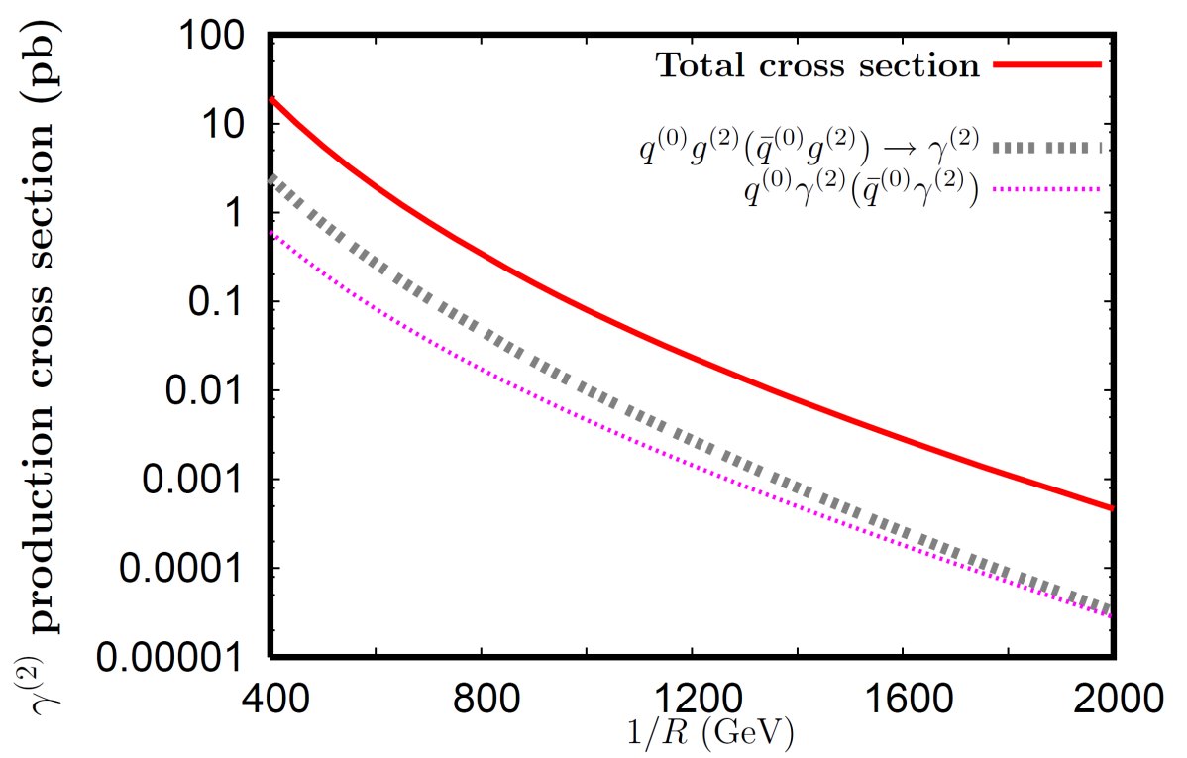
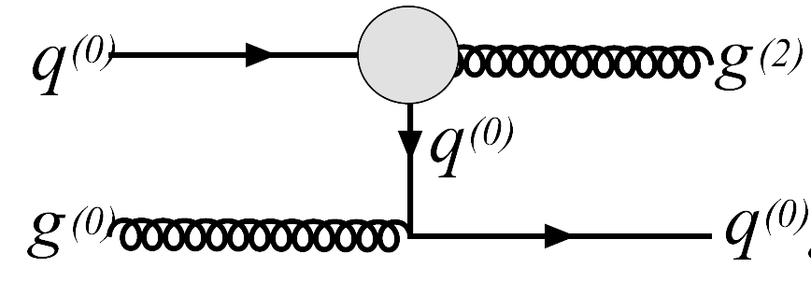
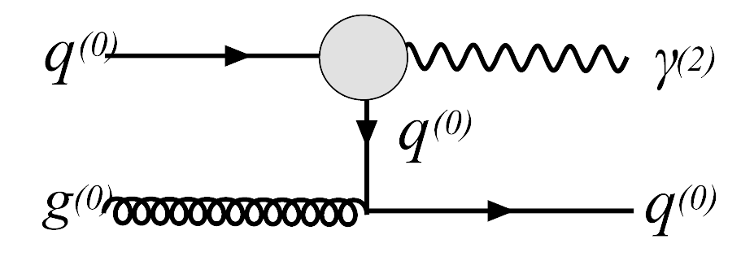
Discussion : significance of each process
Reason why these processes have large cross section
(1) Dominant component of Parton distribution function of proton u-quark, d-quark, gluon
(2) Logarithm factor prevents the drastic decreasing of cross section

Slide 28
Summary
Observation of second KK particles through
Observation of first KK particles
γ
(2)
(2)
( Z )
di-lepton
Speculation of the value of 1/R
Determination of the mass of
γ
(2)
(2)
( Z )
γ
(2)
(2)
Mass of ( ) = Calculated mass from speculated 1/R
Z
Confirmation of the second KK particles !
Confirmation of the MUED model !!

