Slide 1
Summing Up All Genus Free Energy of ABJM Matrix Model
Sanefumi Moriyama (Nagoya U)
JHEP [arXiv:1106.4631]
with H.Fuji and S.Hirano

Slide 2
M is for Mother
5 Consistent String Theories in 10D
Het-E8xE8
IIA
Het-SO(32)
IIB
I

Slide 3
M is for Mother
5 Consistent String Theories in 10D
5 Vacua of A Unique String Theory
Het-E8xE8
IIA
T-duality
T-duality
Het-SO(32)
IIB
S-duality
Orientifold
I

Slide 4
M is for Mother
Non-Perturbative
M2 / M5
M (11D)
Strong Coupling Limit
Het-E8xE8
IIA
10D & Compactifications
Het-SO(32)
IIB
I

Slide 5
M is for Mystery
Little was known before ABJM
11D Supergrav as LowEnergyTheory
Supergrav Sol for M2- & M5-branes
Near Horizon Geometry
Superconformal Symmetry osp(8|4)
Action for Single M2-/M5-brane
DOF N^{3/2}/N³ for N M2-/M5-branes

Slide 6
cf. D-branes
DOF N² for D-branes
Described by
Matrix

Slide 7
M is for Membrane
A breakthrough by ABJM
Non-Abelian M2-brane theory by ABJM [Aharony-Bergman-Jafferis-Maldacena]
Partition Function Localized to CS Matrix [Kapustin-Willett-Yaakov, Hama-Hosomichi-Lee]
Planar N^{3/2} Behavior Reproduced [Drukker-Marino-Putrov]
Today: All Genus Sum

Slide 8
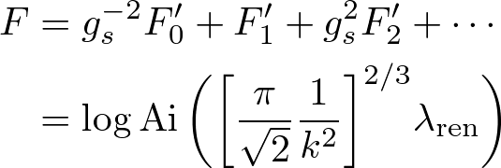
Summary of Strategy & Result
Chern-Simons Theory = Open A-model
Duality: Closed B-model
Holomorphic Anomaly Eq (Recurrence Eq)
Modified Bessel Differential Eq
Solution
Implications?

Slide 9
Contents
Introduction
ABJM Theory
Localization
Planar Limit
All Genus Sum
Discussions

Slide 10
Contents
Introduction
ABJM Theory
Localization
Planar Limit
All Genus Sum
Discussions

Slide 11
ABJ(M) theory (N₁=N₂)
N=6 Chern-Simons-matter Theory
U(N₁)_{k}
A₁, A₂
U(N₂)_{-k}
B₁, B₂
Gauge Field
Gauge Field
Bifundamental Matter Fields
Superpotential
(N₁+N₂)/2 M2 with N₁-N₂ fractional M2 on C⁴ / Z_{k}

Slide 12
N=2 Chern-Simons Theory
Dim Red of 4D N=1
N=2 Vector Multiplet V
L_{gauge} (V) = ...
(Topological & Auxiliary)
N=2 Chiral Multiplet Φ
L_{matter} (Φ) = ...

Slide 13
N=3 Chern-Simons-matter Theory
Field Contents of N=4
Adj Rep
N=4 Vector Multiplet (V , φ)
(CS Term: N=3 / No Kinetic Term for φ)
Conj Rep
N=4 HyperMultiplet (Φ_{i} , Φ_{i}†)
(For General Gauge Groups & Representations)

Slide 14
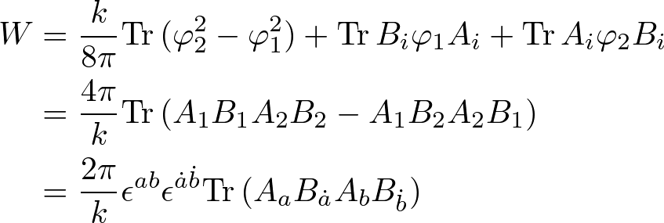
N=6 Chern-Simons-matter Theory
Application to U(N₁) x U(N₂)
U(N₁)_{k}
A₁, A₂
U(N₂)_{-k}
B₁, B₂

Slide 15
N=6 Chern-Simons-matter Theory
R-Symmetry
so(3) = su(2) _{diag} ⊂ su(2)_{A} x su(2)_{B} ⊂ su(4) = so(6)
A₁, A₂
B₁, B₂
su(2)

Slide 16
Brane Construction
N₁ x D3
N₂ x D3
(1,k)5
NS5
NS5 0 1 2 3 4 5
(1,k)5 0 1 2 [3,7]_{θ} [4,8]_{θ} [5,9]_{θ} tanθ = k
D3 0 1 2 6
Preserving N=6 SUSY
(Expected to be N=6 Chern-Simons-matter Theory)

Slide 17
Brane Construction
T₆-duality
(N₁+N₂)/2 x D2
KKm_{(6dual)}
+ k D6
KKm_{(6dual)}
(N₁-N₂) x fractional D2
M-lift
C⁴ / Z_{k}
C⁴ / Z_{k}
(N₁+N₂)/2 x M2
KKm_{(6dual, k x 10)}
KKm_{(6dual)}
(N₁-N₂) x fractional M2

Slide 18
Contents
Introduction
ABJM Theory
Localization
Planar Limit
All Genus Sum
Discussions

Slide 19
Localization
Grassmann-odd Symmetry
Grassmann-odd Quantity
Integration Localized to

Slide 20
Application to ABJM
Grassmann-odd Symmetry δ: Chiral SUSY
Grassmann-odd Quantity V: δV = S_{YM}
Localized to F_{μν} = 0 & D_{μ} σ = 0 (σ = A₄)
Pure Gauge A_{μ} = 0 & Constant σ
Classical Action: Quadratic If Rescaled by t
1-Loop Exact

Slide 21
Application to ABJM
Gauge Field
Matter Field
. . . = cosh⁻²

Slide 22
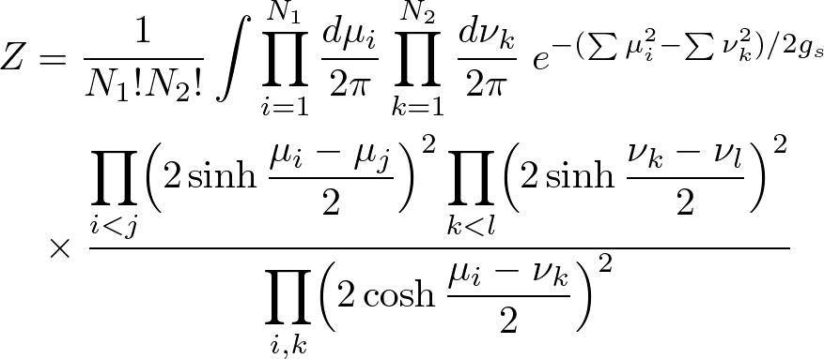
Finally, Localized to Matrix Model

Slide 23
Contents
Introduction
ABJM Theory
Localization
Planar Limit
All Genus Sum
Discussions

Slide 24
ABJM Matrix Model

Slide 25
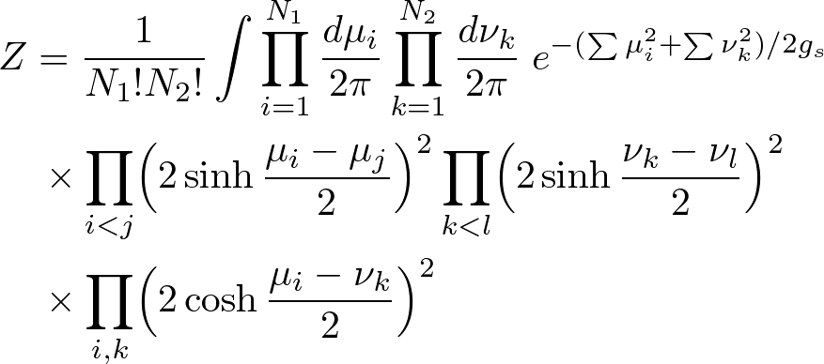
If, instead
Lens Space Matrix Model

Slide 26
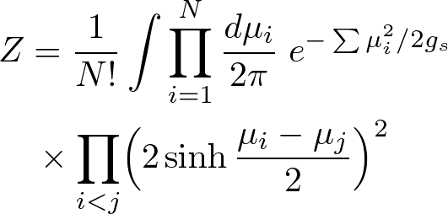
If, further simplified
Chern-Simons Matrix Model

Slide 27
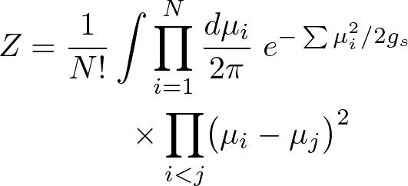
The simplest one
Gaussian Matrix Model
Study from Gaussian MM to ABJM MM

Slide 28
Matrix Model
Eigenvalue Density Wanted
Definition - Resolvent -
Planar Limit
Eigenvalues

Slide 29
Nice Properties of Resolvent
Behavior
Dispersion Relation
EOM ・・・ Discontinuity Eq
Force
Integration

Slide 30
Integration Contour
z
B
A
Resolvent ω₀(z)
Partition Func F₀(λ)

Slide 31
Chern-Simons Matrix Model

Slide 32
Chern-Simons Matrix Model
Resolvent
Asymptotic Behavior
as
Discontinuity Eq from EOM

Slide 33
Chern-Simons Matrix Model
A Regular Function [Halmagyi-Yasnov]
Asymptotic Behavior
Determined!

Slide 34
Lens Space Matrix Model
Lens Space Matrix Model

Slide 35
Lens Space Matrix Model
Same Tech as Chern-Simons Matrix Model
Two Cuts Instead
B
A₁
A₂
sinh
sinh
cosh

Slide 36
ABJM Matrix Model

Slide 37
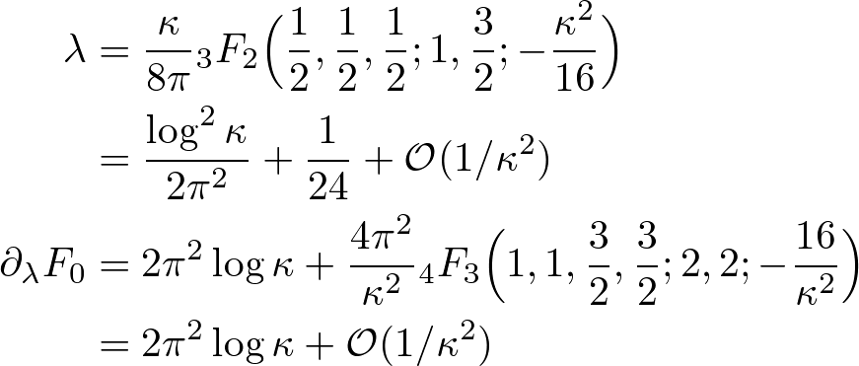
ABJM Matrix Model
Analytic Cont from Lens Space Matrix Model
Result (for ABJM Slice: λ = λ₁ = λ₂)

Slide 38
Result
Result
Neglecting Worldsheet Instanton
N^{3/2} Reproduced and More

Slide 39
Interpretation
Charge Shift [Aharony-Hashimoto-Hirano-Ouyang]
from Euler Coupling
Match in Planar Case

Slide 40
Furthermore, Non-Planar Prediction
Renormalization of 't Hooft coupling
Or in terms of

Slide 41
Contents
Introduction
ABJM Theory
Localization
Planar Limit
All Genus Sum
Discussions

Slide 42
Strategy
Chern-Simons Theory on Lens Space S³/Z₂
(String Completion)
Open Top A-model on T*(S³/Z₂)
(Large N Duality)
Closed Top A on Hirzebruch Surface F₀ = P¹ x P¹
(Mirror Symmetry)
Closed Top B on Spectral Curve u v = H(x,y)
Holomorphic Anomaly Equation!!

Slide 43
Holomorphic Anomaly Eq
General Case [Bershadsky-Cecotti-Ooguri-Vafa]
Determined by F₀: 2nd & 3rd Derivatives

Slide 44
Application to ABJM
One Modulus = Ordinary Differential Eq
2 Cuts = Torus

Slide 45
Derivative
Torus Modulus
Elliptic Int
2nd Derivative
3rd Derivative (Yukawa Coupling)
K: α-cycle
τ
K': β-cycle
1

Slide 46
Ansatz & Reduction
Ansatz for Partition Function
Eisenstein Series
Reduced HAE [Drukker-Marino-Putrov]
Covariant Derivative

Slide 47
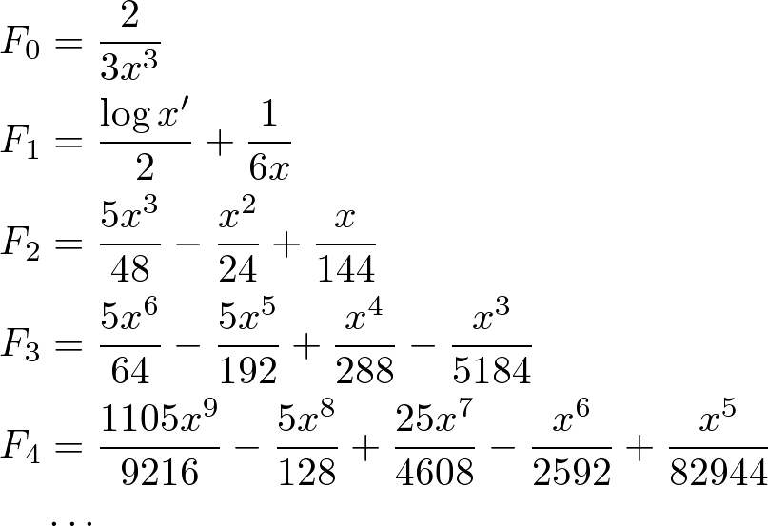
Higher Genus Behavior

Slide 48
Higher Genus Behavior

Slide 49
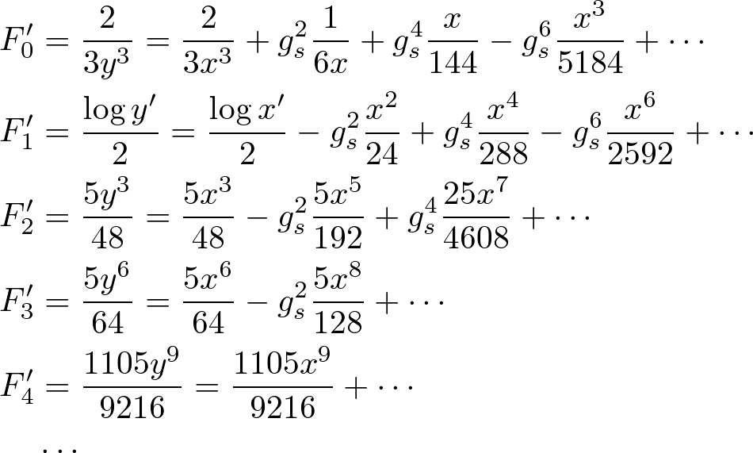
Resum 1
Discrepancy Discussed Later

Slide 50
Resum 2
After Partial Sum
Recursion Relation (cf. SW theory [Huang-Klemm])
Translated into Differential Eq
Solved by Modified Bessel Functions

Slide 51
Airy Function Result
Result [Fuji-Hirano-M]
Airy Function

Slide 52
Contents
Introduction
ABJM Theory
Localization
Planar Limit
All Genus Sum
Discussions

Slide 53
Discrepancy?
SU(N) x SU(N) instead of U(N) x U(N)?
Another Superconformal Theory by ABJM
SU(N) instead of U(N) for D3-branes

Slide 54
Airy Function
Modified Bessel Functions Everywhere as for Loop Operator VEV [Moore-Seiberg-Staudacher, Drukker-Gross]
Cubic Integral Reminiscent of Chern-Simons
Airy Function in Other Setups of M theory "Wave Function of the Universe" [Ooguri-Vafa-Verlinde]
Corrections to Quantum Gravity? Max SUSY ・・・ No Corrections?

Slide 55
Future Directions [work in progress]
Relation to Superalgebra U(N|N)
Airy Function Beyond ABJM Slice
Other Analysis (Surgery?) for WS Instanton
Good Variables for ABJM Theory Three-Algebra? [Bagger-Lambert, Gutsvasson]

