Slide 1
Relationship between marginal deformation parameters in OSFT and boundary CFT
村田 仁樹 (Masaki Murata)
with Matej Kudrna and Martin Schnabl
Institute of Physics AS CR
(Czech Republic)
11.March @Osaka Univ.

Slide 2
SFT reproduces Boundary States
holds within
We computed
Known

Slide 3
Outline
Motivation
CFT Boundary State
KMS Boundary State
Cos X Solution
Compare Boundary States

Slide 4
Background Independence
General Relativity
Background Independence
1. Independent of choice of g
g can be … flat, Schwarzschild, etc
2. Solutions → backgrounds

Slide 5
String Theory is Background Dependent
S-matrix on a fixed background
(Open) String Field Theory (SFT)
1. Formulation depends on background
2. Solutions → other backgrounds

Slide 6
Solutions → Backgrounds
Find solutions
Tachyon condensation
Marginal deformation
Lump
Multiplebrane
Ghost brane
Schnabl, 2005
Kiermaier-Okawa-Rastelli-Zwiebach, 2007
Schnabl, 2007, Kiermaier-Okawa, 2007
Bonora-Maccaferri-Tolla, 2010
MM-Schnabl, 2011
Masuda-Noumi-Takahashi, 2012

Slide 7
CFT Boundary State → Background
CFT Boundary State = label of vacua

Slide 8
KMS Boundary State is Simpler
KOZ boundary state : Non-polynomial
Kiermaier-Okawa-Zwiebach, 2008
KMS boundary state : Linear
Ellwood, 2008
Kudrna-Maccaferri-Schnabl, 2012
Compare
CFT boundary state

Slide 9
Outline
Motivation
CFT Boundary State
KMS Boundary State
Cos X Solution
Compare Boundary States
Compare

Slide 10
Boundary Condition gives
CFT Boundary State
Two aspects of
D-brane
N
D
open string
boundary conditions
Emit (absorb)
closed string
CFT Boundary state

Slide 11
Cos X deformation
deformation parameter
Neumann
Dirichlet
D25 → D24

Slide 12
Outline
Background independence
CFT Boundary state
KMS Boundary State
Cos X Solution
Compare Boundary States
Compare

Slide 13
KMS Boundary State
Ellwood, 2008
Kawano-Kishimoto-Takahashi, 2008
Kudrna-Maccaferri-Schnabl, 2012

Slide 14
Sample computation of
For Fock states

Slide 15
Outline
Background Independence
CFT Boundary States
KMS Boundary State
Cos X Solution
Compare Boundary States
Compare

Slide 16
Cos X deformation
deformation parameter
Neumann
Dirichlet
D25 → D24

Slide 17
Cos X solution
SFT solution in quasi Schnabl gauge
Kiermaier-Okawa-Rastelli-Zwiebach, 2008
Q : Related to Cos X deformation?
vs
?

Slide 18
Outline
Background Independence
CFT Boundary States
KMS Boundary State
Cos X Solution
Compare Boundary States
?

Slide 19
Comparing Boundary States
?
CFT :
SFT :
?

Slide 20
Results
?
up to
Consistency :
holds within

Slide 21
Summary and Future works
quasi Schnabl
Kudrna-Masuda-Okawa-Schnabl-Yoshida, 2012
Siegel
Systematic way for higher order
Higher level in Siegel gauge

Slide 22
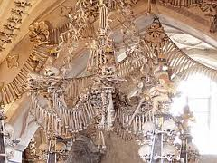
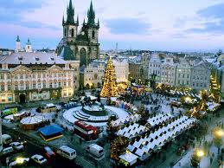
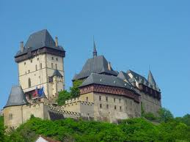

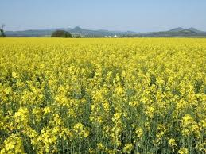

Thank you!!

Slide 23
App : CFT Boundary sate
boundary conditions
→ backgrounds of open string
CFT Boundary state
Neumann:
Dirichlet:

Slide 24
App : Gauge dependence
Gauge invariant
Gauge dependent
depends on gauge

Slide 25
App: Siegel gauge
Kudrna-Masuda-Okawa-Schnabl-Yoshida, 2012
Integrate out
Boundary state
based on data with L<13

