Slide 1
Holographic
Interface

Slide 2
Collaboration with
共同研究者
K. Nagasaki
長崎君
H. Tanida
谷田君
K. Nagasaki, SY, arXiv:1205.1674 [hep-th]
K. Nagasaki, H. Tanida, SY, JHEP 1201 (2012) 139

Slide 3
Main achievement
主要な結果
(Gauge theory calculation)
ゲージ理論の計算
(Gravity calculation)
重力の計算

Slide 4
Evidence for
（ゲージ理論）＝（重力理論） の証拠
(Gauge theory)=(Gravity)

Slide 5
Interface ?

Slide 6
Interface
QFT
QFT

Slide 7
Point of view―Extension of boundary CFT
境界のあるCFTの拡張
Interface
Boundary
Boundary CFT
Interface CFT
CFT
CFT

Slide 8
Point of view－ test membrane
試験膜
4 dim
Test particle
(Wilson loop,
’t Hooft loop,...)
試験粒子
Test membrane
(Interface)
試験膜

Slide 9
Motivations
Statistical mechanics
統計力学
String worldsheet
弦の世界面
Extra dimensions
in particle physics
素粒子論で余剰次元
AdS/CFT correspondence
AdS/CFT対応

Slide 10
Holography ?

Slide 11
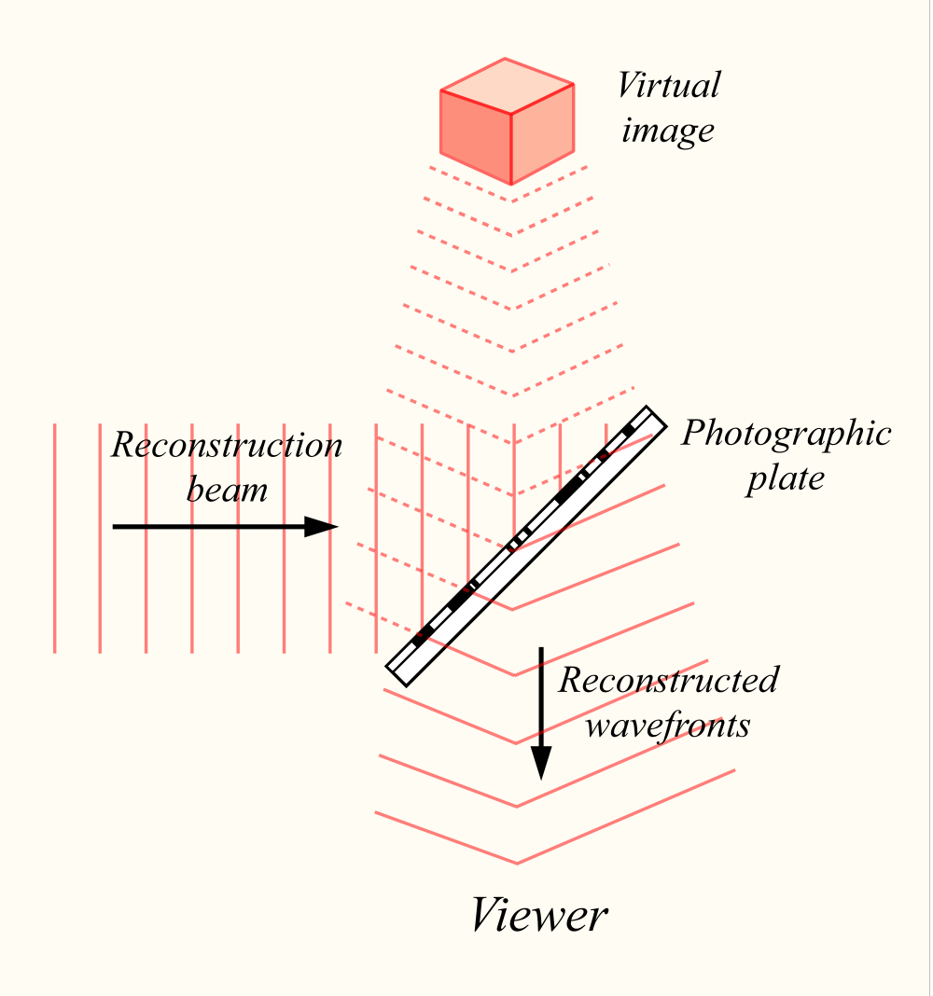
Holography

Slide 12
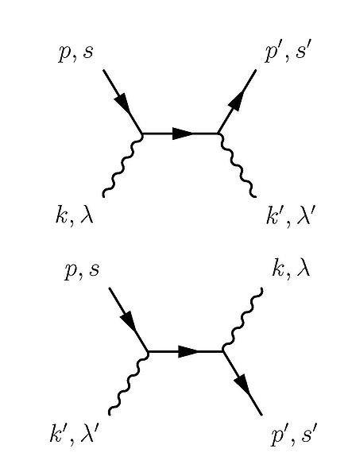
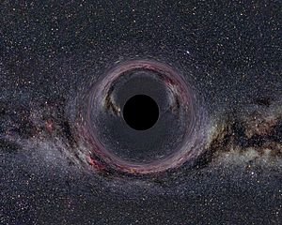
Holography (AdS/CFT correspondence)
(Gravity) = (Lower dimensional non-gravitational QFT)
重力
低次元の重力でない場の理論

Slide 13
AdS/CFT Correspondence
Certain gravity
theory
(String theory)
Quantum field theory without gravity
Brane, etc
Interface
Want to check

Slide 14
Physical quantities
One point function of local operators
ｘ

Slide 15
Strategy
Gravity
Gauge theory
One point function
Prescription
QFT
QFT
Compare
Classical calculation
Result
in gravity
Result in
gauge theory

Slide 16
Result
Agree nontrivially
非自明な一致

Slide 17
②
①
Gravity
Gauge theory
重力
ゲージ理論
Why agree？
なぜ一致？

Slide 18
Gauge theory side

Slide 19
N=4 Super Yang-Mills
Fields
Adjoint rep. of the gauge group SU(N)
ゲージ群SU（N）の随伴表現
Action

Slide 20

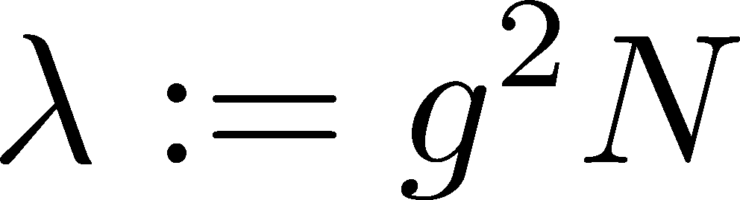



Large N limit
: gauge coupling
ゲージ結合定数
: ’t Hooft coupling
Large N limit
Fix
固定

Slide 21
is the loop expansion parameter
がループ展開のパラメータ

Slide 22


1/2 BPS Interface
Junction condition (boundary condition) here
ここで接続条件（境界条件）
Use
Fuzzy funnel background
[Constable, Myers, Tafjord],
[Gaiotto, Witten]

Slide 23
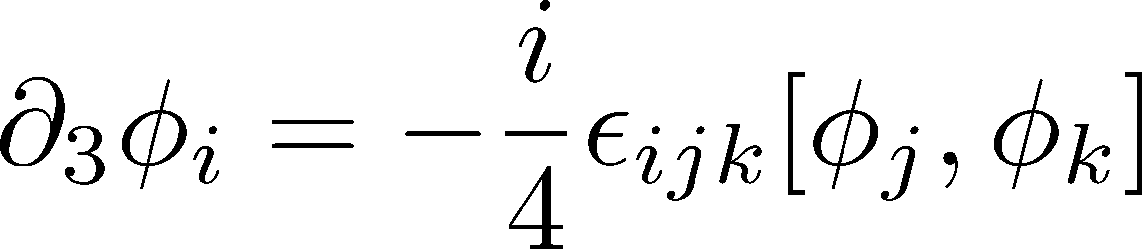
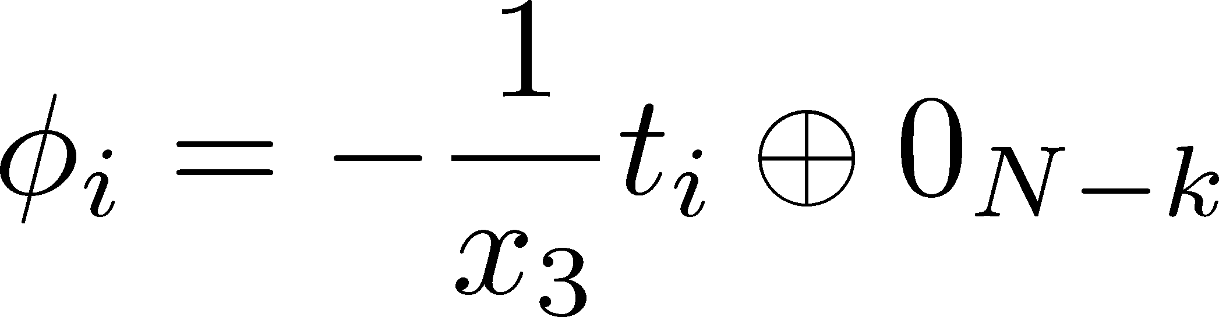
1/2BPS Nahm equation
Solution
k dim irrep of SU(2)
SU(2)のk次元既約表現

Slide 24
Path integral with the boundary condition
that fields approach to the solution in
でこの解に近づくような境界条件の元で経路積分を行う

Slide 25
One point function
Chiral primary operator
Traceless symmetric

Slide 26
Evaluate one point function classically
１点関数を古典的に評価する
Just substitute
代入するだけ

Slide 27
Example 例
Quiz 小テスト
= ?
k dim irrep of SU(2) のk次元既約表現

Slide 28

The answer

Slide 29
The correct answer

Slide 30
One point function --- result

Slide 31
Gravity side

Slide 32
AdS/CFT correspondence
IIB Superstring
AdS5 x S5
4dim N=4 SYM
SU(N)
?
Interface ?

Slide 33
D3 system
type IIB string
N D3-branes
0123 direction
open string
low energy
Near horizon
AdS5 x S5
4dim N=4 SYM

Slide 34
D3-D5 system
1 D5-brane 012 456 direction
Near horizon
Low energy
N D3-brane
0123 direction
N-k
AdS5 x S5
+
D5-brane probe
AdS4 x S2
(with magnetic flux)
SU(N-k) SU(N)
Interface

Slide 35
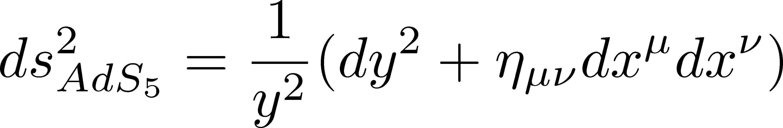








Description in the gravity side
[Karch, Randall]
D5-brane
magnetic flux

Slide 36
One point function
Scalar field
GKPW
source

Slide 37
Result

Slide 38


Comparison to the gauge theory side
Gauge
（ ：Large）
Agree
Gravity
（ ：Large）

Slide 39
Summary

Slide 40
One point function
AdS5 x S5
N=4 SYM
probe D5-brane
One point function
SU(N-k)
SU(N)
GKPW
Classical calculation
Agree

Slide 41


Why agree?
Calculation in gravity side
？
Calculation in gauge theory side
Valid in
Valid in
Gravity side
Positive power series in
since k is large.
cf [Berenstein, Maldacena, Nastase]

Slide 42
Future problem
Can reproduce from the perturbative calculation in the gauge theory side?

Slide 43
Thank you

