Slide 1
Position space formulation of the Dirac fermion on honeycomb lattice
Tetsuya Onogi with M. Hirotsu, E. Shintani
January 21, 2014 @Osaka
Based on
arXiv:1303.2886(hep-lat), M. Hirotsu, T. O., E. Shintani

Slide 2
Outline
Introduction
Graphene
Staggered fermion
Position space formalism for honeycomb
Exact chiral symmetry
Summary

Slide 3
1. Introduction

Slide 4
Dirac fermion in condensed matter system:
A new laboratory for lattice gauge theory
Condensed matter
New hint
Lattice gauge theory
Theoretical tool

Slide 5
Dirac fermion in condensed matter systems
Graphene
Topological insulator
Electrons hopping
on the atomic lattice
massless Dirac fermions at low energy
Rather surprising phenomena:
Consistent with Nielsen-Ninomiya theorem?
Why stable?

Slide 6
Nielsen-Ninomiya’s no-go theorem:
Lattice fermion with both exact chiral and
exact flavor symmetry does not exist.
Wilson fermion : chiral symmetry ❌
Staggered fermion : flavor symmetry ❌
Domain-wall/overlap fermion : flavor symmetry ⭕
chiral symmetry ⭕ (modified)
Dirac fermions in condensed matter: something new?
→ Let us study the structure of Dirac fermion in
graphene system as a first step!

Slide 7
We refomulate the tight-binding model for graphene position space approach
We find
Graphene is analogous to staggered fermions.
Spin-flavor appears from DOF in the unit cell.
Hidden exact chiral symmetry.

Slide 8
2. Graphene

Slide 9
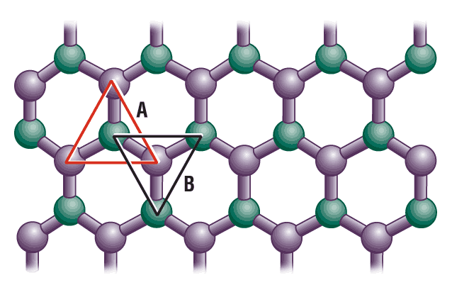

1. Graphene
Mono-layer graphite with honeycomb lattice
Semin-conductor with zero-gap
Novoselov, Geim Nature (2005)
High electron mobility
Si:
Ge:
Notes:
グラフェンのレビュー
炭素のハニカムシートであること。
単原子層で純粋な２次元系であること。
フラーレン等、炭素素材の基礎であること。
電気伝導を担うのはπバンド。
ハーフフィリング。
蜂の巣格子を反映して電子構造が特殊であること。
具体的にはディラック電子とそれに基づく、高移動度、量子ホール効果。

Slide 10
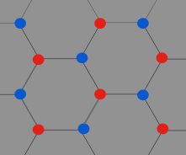
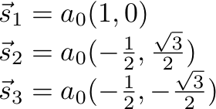
Tight-binding model on honeycomb lattice
・ A site
・ B site

Slide 11
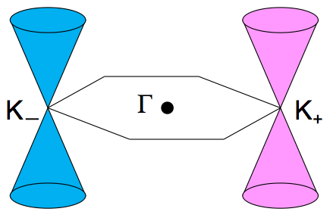
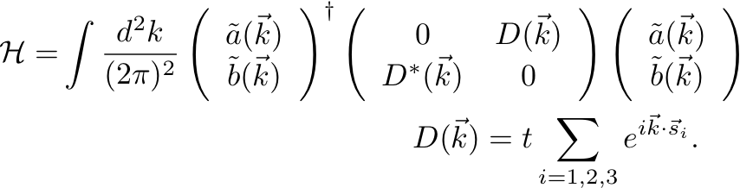
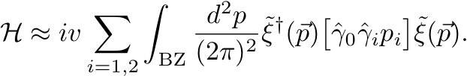
Momentum space formulation, Semenoff, Phys.Rev.Lett.53,2449(1984)
Hamiltonian has two zero points in momentum space: D(K)=0
Low energy effective theory
is described by Dirac fermion.

Slide 12
The reasoning by Semenoff is fine.
However, we do not know
origin of spin-flavor
why zero point is stable
whether the low energy theory is local or not when we introduce local interactions in position space.

Slide 13
Graphene system looks similar to staggered fermion.
single fermion hopping on hypercubic lattice generates
massless Dirac fermion with flavors
Two approach in staggered fermion
Momentum space approach
Susskind ‘77, Sharatchandra et al.81, C.v.d. Doel et al.’83, Golterman-Smit’84
Almost the same logic as Semenoff
Position space formulation … Kluberg-Stern et al. ’83
Split the lattice sites into “space” and “internal” degrees of freedom.
Exact chiral symmetry is manifest.
This approach is absent in graphene system.
We try to construct similar formalism in graphene system.

Slide 14
2. Staggered fermion

Slide 15
Comment:
Hamiltonian of Graphene model
➔ spatial lattice and continuus time
Hamiltonian for staggered fermion
➔ spatial lattice and continuus time
Path-integral action for staggered fermion
➔ space-time lattice
Good analogy
We take this example to explain the idea for simplicity.
Please do not get confused.

Slide 16
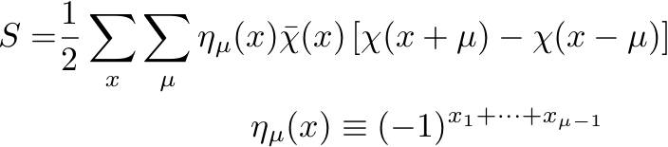

Staggered fermion action in d-dimension
Position space formulation:
Re-labeling of the staggered fermion by splitting lattice sites into “space” and “internal” degrees of freedom
We can re-express the kinetic term using tensor product of (2x2 matrices)

Slide 17
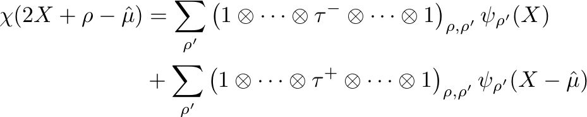
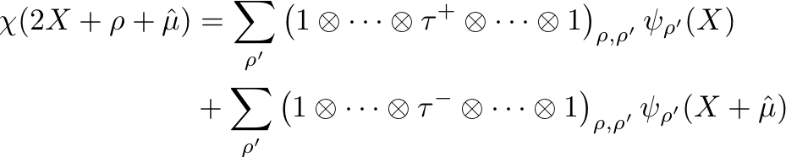

Matrix representation of the pre-factor
Matrix representation of forward- and backward- hopping

Slide 18
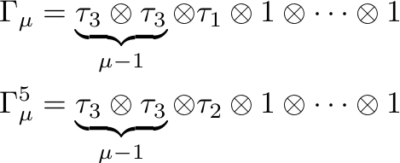
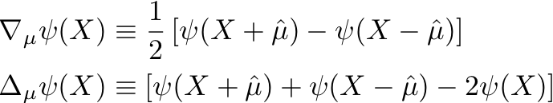
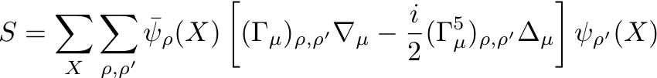
Substituting the matrix representation, we obtain
where
The theory is local.
Massless Dirac fermion at low energy.

Slide 19




d=2 case: 2-flavor Dirac fermion
Exact chiral symmetry on the lattice
Because
This symmetry protects the masslessness of the Dirac fermion.

Slide 20
Position space formalism is useful
understanding the symmetry structure
  (order parameter, phase transition, …)
classifying the low energy excitation spectrum

Slide 21
4. Position space formulation for honeycomb

Slide 22

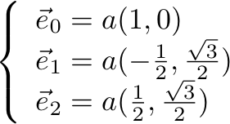
Position space formulation
Creation/Annihilation operators
Fundamental lattice
： central coordinate
of hexagonal lattice
： index for sublattices A,B
： 3 vertices(0,1,2)
Fundamental vectors
（a：lattice spacing）

Slide 23
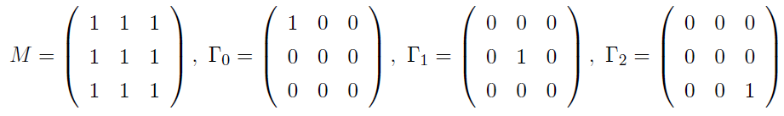
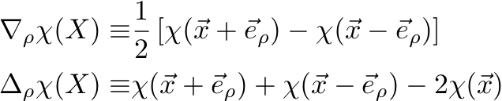
New formulation of tight-binding Hamiltonian

Slide 24
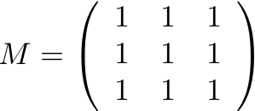
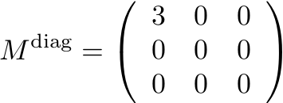
Separation of massive mode and zero modes
Democratic matrix
Massive mode
Change of basis
Massive mode can be integrated out
Zero mode

Slide 25
Effective hamiltonian
1st derivative
O(a)
Low energy limit
Integrating out heavy mode

Slide 26



Possible global symmetry of Heff
“Chiral” symmetry
Global symmetry broken by parity conserving mass term
（Gap in the graphene)
However, these could be violated by lattice artefacts.

Slide 27
4. Exact chiral symmetry

Slide 28



Chiral symmetry on honeycomb lattice
Naïve continuum chiral symmetry is violated by lattice artefact .
Following overlap fermion, we allow the lattice chiral symmetry
to be deformed by lattice artifact.
i.e. in Fourier mode, it can be momentum dependent.
Expanding in powers of momentum k, we looked for
which commutes with Hamiltonian order by order.
Series starting from failed at 2nd order in k.
Series starting from survived at 3rd order in k
→ All order solution may exist?

Slide 29


Based on the experience in momentum expansion, we take the following anzats for the chiral symmetry
We impose the condition that the above transformation
should keep the Hamiltonian exactly invariant
We obtain a set of algebraic equation with
(anti-)commutation relations involving
and the matrix appearing in the Hamiltonian

Slide 30
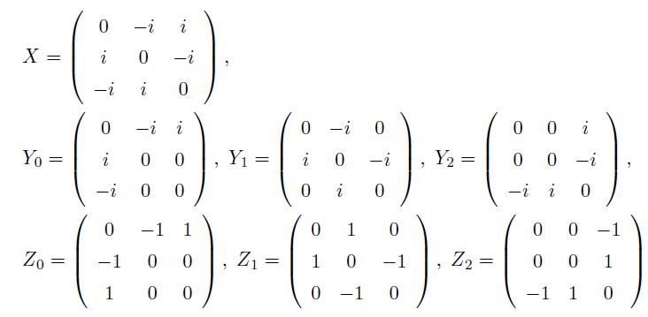
We find that the solution of the algebraic equation is unique.
X, Y, Z in the massare given as
Continuum limit
Coincide with
“chiral sym.”

Slide 31
It is found that there is an exact chiral symmetry even with finite lattice spacing.
We can also easily show that this symmetry is preserved with next-to-nearest hopping terms.
Symmetry reason for the mass protection.

Slide 32
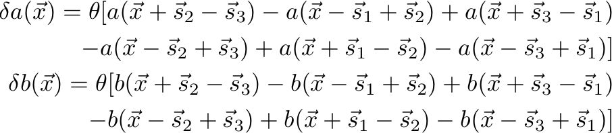
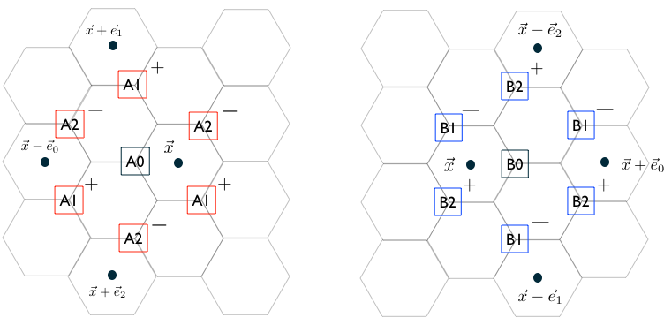
Chiral symmetry in terms of conventional labeling

Slide 33
Summary
Position space formulation
Results
Spin-flavor structure
Identified the DOF in position space
Manifest locality of the low energy Dirac theory
Discovery of the Exact chiral symmetry on the lattice

Slide 34
What is next?
Study of the physics of graphene including gauge interaction
manifest symmetry
both gauge interactions and Dirac structure can be
treated in position space
Derivation of lattice gauge theory is in progress
Velocity renormalization
Quantum Hall Effect
Extention to bi-layer graphene
Effect of inter-layer hopping to chiral symmetry strucutre
→ mass mixing in many-flavor Dirac fermion

Slide 35
Thank you for your attention.

