Slide 1
Novel universality and in the SO(5) x U(1) gauge-Higgs unification
Higgs decay
Takuya SHIMOTANI
Osaka university
collaborators: S. Funatsu, H. Hatanaka, Y. Hosotani, Y.Orikasa
This talk is based on Phys.Lett.B722(2013)94–99
2013/5/28 @ Osaka university
Notes:
Thank you very much for this opportunity. I try to speak in English. But, if you have a question, please ask me in English or Japanese. OK. I’ll talk about phenomenology of the GHU model. This talk is based on this paper and collaborators are almost here.

Slide 2
Introduction for m1 students
2013/3/14
“a Higgs boson” at LHC
What is the Higgs boson?
EW Spontaneous Symmetry Breaking
The VEV of the Higgs gives
mass the W, Z and fermions through yukawa interactions.
problem
We don’t know detail of the Higgs.
Fine tuning problem
Notes:
I’m going to brief introduction for m1 students. Today I’m talking about a Higgs boson. This particle is the last piece of the standard model, and Higgs is discovered last year. However, maybe M1 students don’t know What is important. Higgs boson play a role of the electroweak symmetry breaking. And after the SSB, that vacuum expectation value gives masses the gauge bosons and fermions through the yukawa interactions. This is called Higgs mechanism. However, we don’t know the shape of Higgs potential and Higgs mass has fine tuning problem.

Slide 3
Introduction for m1 students
Fine tuning??
ex) Planck scale
GeV
126 GeV
Top loop
BSM
SUSY
Technicolor
Extra dimension
Higgs sector
Notes:
What is the fine tuning? This is physical Higgs mass. And these are tree level Higgs mass and loop contribution. For the simplicity, I write the top loop only. This is the ultraviolet cutoff. If you choose the Planck scale, and tree level mass also order 10 to 38 GeV. After that, this subtraction has miracle cancellation, and Higgs mass have 126GeV. This is unnatural. So we call this situation, fine tuning problem, hierarchy problem, and naturalness. We want to solve this problem. This is the motivation of the beyond the standard model. Many model is constructed. Adding Supersymmetry, Higgs is bound states, we introduce the extra dimension, and Adding other Higgs. Last one has the minimal extension of standard model. They don’t have the motivation of fine tuning. This is the end of introduction for mi1 students. I’ll talk about attractive model of the extra dimension model, gauge-Higgs unification model.

Slide 4
Introduction
Gauge-Higgs Unification(GHU) model
extra dimensional
gauge field
Higgs field
Hosotani mechanism
EW SSB by Wilson line phase
Y. Hosotani (1983)
good points
no fine tuning
1-loop effective potential (Higgs mass) is finite .
Higgs potential is given by the gauge principle.
Notes:
I explain the GHU. Using the Hosotani mechanism, the extra dimensional gauge field become the Higgs boson. Hosotani mechanism is the EW SSB mechanism. When the extra dimension is not the simply-connected, Wilson loop has the non-trivial phase. Symmetry is broken by this phase, thetaH. This model has good points. 1-loop effective potential and Higgs mass is finite. And Higgs potential is given by the gauge principle. This model has no Higgs potential by hand.

Slide 5
Points of my talk
NEW1
gauge-Higgs unification model
We can get 126GeV Higgs boson with extra fermions.
And we discovered universality.
NEW2
Contributions of KK modes are small.
Sign of couplings are alternate as n increases.
10% (1%) suppression
Notes:
OK. I talk about plan of my talk and this is the summary. I have 2 parts. Firstly, I talk about SO(5) cross U(1) gauge-Higgs unification model. This model has been modified by adding new fermions. Our new model has 126GeV Higgs boson which can observed. And we found universalities in our model. Origin of this universality is not known. Secondly, we calculated Higgs decay rate. Higgs to two gamma are suppressed from 10% to 1% compared to the value of SM. In 10% case, mKK is 3TeV. In 1% case, mKK is 7TeV.

Slide 6
SO(5)×U(1)
gauge-Higgs unification model
Notes:
Let’s begin the first part.

Slide 7
SO(5)×U(1) GHU Model
K. Agashe, R. Contino, A. Pomarol( 2005)
Y. Hosotani, K. Oda, T. Ohnuma,Y. Sakamura (2008)
Y. Hosotani, S. Noda, N. Uekusa (2009)
OLD
5-dim. Randall-Sundrum warped spacetime
matter contents
brane scalar
Minimal Model
brane fermions
Planck brane
vector rep.
TeV brane
Hosotani mechanism
B.C.
brane scalar
Notes:
Now, I explain the previous version GHU model. This model is 5 dimensional Randall-Sundrum warped spacetime. Topology is S1 over Z2. Fermions represented by vectorial representation are on the bulk. Standard model fermions, top and bottom, are here. The other generation are also here. Gauge symmetry is SO(5) cross U(1) on the bulk. This symmetry breaks SU(2)L cross U(1)Y by boundary condition and brane scalar. And then SU(2)L cross U(1)Y breaks U(1)_EM by using Hosotani mechanism when the .vev of extra dimensional gauge field is not zero. Next we add the extra fermions.

Slide 8
SO(5)×U(1) GHU Model
S. Funatsu, H. Hatanaka, Y. Hosotani, Y.Orikasa, T.S. (2013)
NEW
5-dim. Randall-Sundrum warped spacetime
matter contents
NEW
spinorial rep.
brane scalar
extra fermion
brane fermions
Planck brane
vector rep.
TeV brane
Hosotani mechanism
B.C.
brane scalar
Notes:
This is the new model. The point is just the extra fermion. These fermions are represented by spinorial representation. Difference of two kinds of fermions is periodicity. Verctorial one has pi, spinorial one has 2pi periodicity. I’ll talk about periodicity later. I comment the degree of freedom in this model.

Slide 9
parameters
parameters
input parameters
We have only 2 degrees of freedom.
Notes:
We have parameters. This warp factor, zL, come from the metric, and this is curvature. These are gauge coupling, These parameters are related fermion mass. And nF is number of the extra fermions, cF is related extra fermions’ mass. Input parameter are these. they determine these blue colored regions. Therefore we have only 2 degrees of freedom. Well, we want to explain the Higgs boson at LHC. Our strategy is the firstly calculating Higgs 1-loop effective potential and secondly getting the Higgs mass by the effective potential.

Slide 10
How to calculate
VEV of extra dimensional gauge field:
determined by effective potential
self-consistently
determined
masses
effective potential
determined by
determined by masses
We must choose
which is satisfying in this picture.
Notes:
Therefore I explain the method to calculation of the effective potential. We denote the vev of the gauge field is thetaH.
OK. This effective potential is given by the mass of the particles. So we should calculate the mass. However, mass is given by the thetaH. thetaH is determined by effective potential. Therefore we must calculate self-consistently.

Slide 11
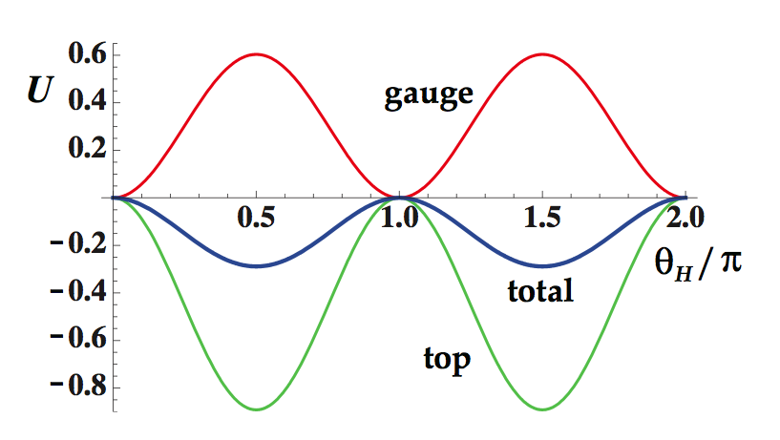
Effective potential
OLD
π periodicity
couplings (e.g. HWW,HZZ, yukawa)
Stable Higgs
Notes:
We can calculate a effective potential. This is old model case. In this model, Wlison line phase is always pi over two. And HWW, HZZ and yukawa couplings are proportional to cosine thetaH. Therefore, Higgs cannot decay easily. This Higgs is stable. We don’t want such a Higgs. We need to change value of thetaH. Therefore, we need extra fermions.

Slide 12
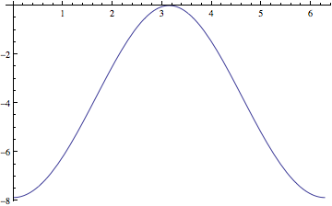
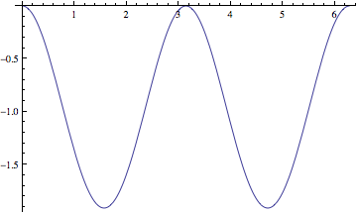
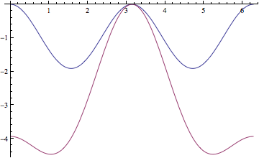
Effective potential
Example
gauge boson
vector rep. fermion
extra fermion
+
2π periodicity
π periodicity
=
total
Notes:
This potential given by the extra fermions. You can see this potential have 2pi periodicity. And top contribution is pi periodicity. And then we can get the thetaH minimum.

Slide 13
Effective potential
NEW
2π periodicity
zoom up!
Notes:
Therefore we can get this effective potential. And this potential give us the Higgs mass is 126GeV.

Slide 14
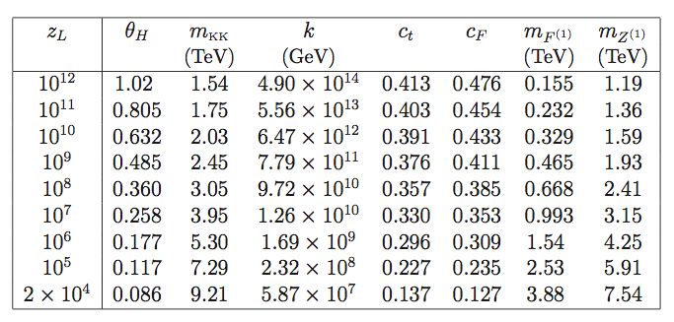
Result 1
case
Current data say,
.
,
.
heavy
ATLAS Collaboration, ATLAS-CONF-2012-129
CMS Collaboration, CMS-PAS-EXO-12-015
CMS Collaboration, CMS-PAS-EXO-11-090
Notes:
This is the first result of us. The number of extra fermions is three. When warp factor is small, thetaH is also small. but mKK, first KK Z and first KK extra fermion are large. Small thetaH give large mass. So this is the standard model limit, we think. Current date say first KK Z mass is larger than 2.5TeV and first KK extra fermion mass is larger than 0.5TeV. Under red line this region is favored. We can search this first KK Z as Z’ at LHC. UED model doesn’t have Z’. This 1st KK Z boson is also characteristic thing.

Slide 15
Result 1
case
We use these value as benchmarks.
Current data say,
,
.
ATLAS Collaboration, ATLAS-CONF-2012-129
CMS Collaboration, CMS-PAS-EXO-12-015
CMS Collaboration, CMS-PAS-EXO-11-090
Notes:
So we use two values. By the way, we calculated other numbers of extra fermions. Amazingly, we discovered universalities.

Slide 16
Universality
Result 2
vs.
independence of the # of extra fermions.
Notes:
ThetaH and mKK, have a relation in 126GeV case. Fitting function is like this. This relation is independent of the number of extra fermions. However, our key particle is extra fermion. This is mysterious. We don’t know origin of this relation. And we found the new plot.

Slide 17
Universality
Result 2
vs.
independence of the # of extra fermions.
Notes:
nF=0 case is also in this relation. This relation say, if we know the mkk, we get thetaH independent of extra fermion and we can determine other particles mass.

Slide 18
Universality
Result 2
Higgs cubic coupling
Higgs quartic coupling
independence of the # of extra fermions.
Notes:
And, we also discovered two relation about Higgs cubic and quartic coupling.
The number of extra fermions does not depend on the detail of the model. When thetaH is zero. GHU couplings are as same as the standard model’s one. However, HIggs cubic and quatic couplings are different from standard model. And quartic coupling has minus region. However it’s no problem because effective potential is periodic.

Slide 19
production & decay
Higgs
Notes:
Next we are going to decay rate.

Slide 20
Higgs decay
charge of F
Notes:
Higgs to gamma process has 3 main contributions. We use the these formulas. They are defined by textbook, the Higgs hunters guide. QX is the U(1)X charge. This factor is enhancement factor. But we are not interested in this enhancement. Therefore we take zero.

Slide 21
Higgs decay
Notes:
We discuss the this formula. Our GHU model, surprisingly Higgs decay rate is finite, if you sum all KK modes. We don’t have enough time, so I explain the only curly F top.

Slide 22
Amplitudes a finite!
The sign alternates
as n increases.
Contributions of KK modes
are very small
because of their masses.
(KK mode)
Convergence
,
,
Notes:
I’ll talk about convergence of top contribution. Well, dependence of KK mode is appeared 3 parts in curly F top. For F one half, when tau go to infinity, this is constant for large n. So we consider the F one half is constant. Next, We calculate behavior of the ratio of yukawa. We defined It. Please watch this graph. Horizontal line is number of KK mode. Firstly, you can see the sign alternates as n increases. This comes from the coupling, coupling alternate. This behavior is typical thing of GHU theory. In UED case, its couplings don’t alternate. Second, absolute value of I is constant. So ratio of yukawa behave -1 to n. And last, we focus on the ratio of mass. mtndepend on KK mode. For large n, mtn behaves n times mKK. -1 and n inverse and constant. So this curly F behaves this sum. And this sum can converge. Therefore, amplitude is finite. The others of culy F are also finite. Contribution of KK mode are small because of their mass.

Slide 23
In a similar way,
,
N. Maru, N. Okada (2008)
A. Falkowski (2008)
Notes:
In a similar way, we can calculate gluon fusion. Like this. But I focus on H to two gamma only.

Slide 24
Contributions of amplitudes
Result 3
0.117
0.360
8.330
7.873
0.9996
0.998
KK W negative
-1.372
-1.305
0.998
0.990
KK top positive
-0.0034
-0.033
F positive
6.508
6.199
1.001
1.011
KK positive
Notes:
This is the result 3. We calculate two case. ThetaH are 0.117 and 0.360. We calculate ratios. This tell us the KK W contribution is negative. KK top contribution is positive. And extra fermion contribution is positive. Last part tell us the KK mode contribution is positive and very small.

Slide 25
Decay rate
Result 3
couplings (e.g. HWW, HZZ, yukawa)
Higgs decay rates are suppressed by
.
For
n_{F}=3, θ_{H}=0.360 (0.117)
Compared to the value in the SM,
is suppressed 10 % (1 %)
including contributions of KK mode
2%(0.2%).
Notes:
Then, In SO(5) cross U(1) GHU model, HWW, HZZ and yukawa coupling has this form. Therefore main suppression factor is square of cosine thetaH. In this case, compared to the value in standard model, decay rate is suppressed 10% or 1%. Contributions of KK mode are enhancement factors. However, they are very small, 2% or 0.2%.

Slide 26
Summary
NEW1
gauge-Higgs unification model
We can get 126GeV Higgs boson with extra fermions.
And we discovered universality.
NEW2
Contributions of KK modes are small.
Sign of couplings are alternate as n increases.
10% (1%) suppression
Notes:
Let me summarize. Plan of my talk is my conclusion. SO(5) cross U(1) GHU model can make a Higgs. And we discovered universalities. Origin of this universality is unknown. Decay rate are suppressed from 10% to 1% compared to the value of SM. Main suppression factor is square of cosine thetaH. Our first KK Z and extra fermions are accessible at LHC. Thank you very much.

Slide 27
BACK UP
A

Slide 28
Signal strength
Remark of Result 3
Contributions of KK mode are small.
All Higgs decay rates are suppressed by
.
Branching fractions are not suppressed by
.
The GHU model predicts
observed event rate
relative to the SM is

Slide 29
case
Result 3
Large
is enhanced.

Slide 30
Universality
Result 2
vs.
independence of the # of extra fermions.
Notes:
ThetaH and mKK, have a relation in 126GeV case. Fitting function is like this. This relation is independent of the number of extra fermions. We don’t know origin of this relation.

Slide 31
Color triplet case
,

Slide 32
Amplitudes a finite!
For KK W

Slide 33
Amplitudes a finite!
For KK F

