Slide 1

Topological Quantum Phenomena and Gauge Theories
Kyoto University, YITP, Masatoshi SATO

Slide 2


In collaboration with
Mahito Kohmoto (University of Tokyo, ISSP)
Yong-Shi Wu (Utah University)
“Braid Group, Gauge Invariance, and Topological Order”,
MS. M.Kohmoto, and Y.-S. Wu, Phys. Rev. Lett. 97, 010601 (06)
“Topological Discrete Algebra, Ground-State Degeneracy, and Quark Confinement in QCD”,
MS. Phys. Rev. D77, 0457013 (08)
Review paper on Topological Quantum Phenomena
Y. Tanaka, MS, N. Nagaosa, “Symmetry and Topology in SCs” JPSJ 81 (12) 011013
T. Mizushima, Tsutsumi, MS, Machida, “Symmetry Protected TSF 3He-B” arXiv:1409.6094

Slide 3
Outline
Part 1. What is topological phase/order
General idea of topological phase/order
Topological insulators/superconductors
Part 2. deconfinement as a topological order

Slide 4
What is topological phase/order ?
Phase or order that can be classified by “connectivity”
Connected (globally)
topologically non-trivial
Not connected
topologically trivial

Slide 5
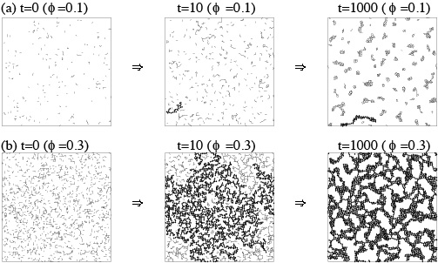


Gelation
cross-link
polymer
gel
Not connected
connected
Ohira-MS-Kohmoto Phys. Rev. E(06)

Slide 6
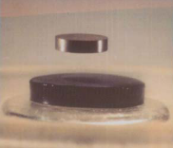
Two distinct concepts of phases
Nambu-Landau theory
Phase classified by connectivity
classical phase
topological classical phase
phase transition at finite T
spontaneous symmetry breaking
phase transition at finite T
classical entanglement
thermal fluctuation
topological quantum phase
quantum phase
phase transition at zero T
quantum entanglement
phase transition at zero T
spontaneous symmetry breaking
quantum fluctuation

Slide 7
What is quantum entanglement ?

Slide 8
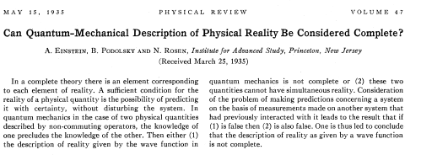

Entanglement in quantum theories
Not directly observed
$$\left|\left.Ψ\right\rangle \right.$$
state vector ≠ observable
(probability wave)
Non-locality specific to quantum theories
Einstein-Podolsky-Rosen paradox

Slide 9


How to study entanglement in quantum theories
0. Use entropy
Examine cross sections
Directly examine entanglement

Slide 10
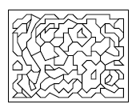
1. Examine cross sections
Topological quantum phase
= “connected” phase
“Not connected”
movable (=gapless )
new degrees of freedom

Slide 11
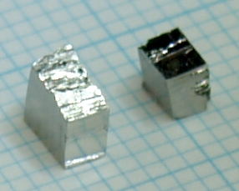
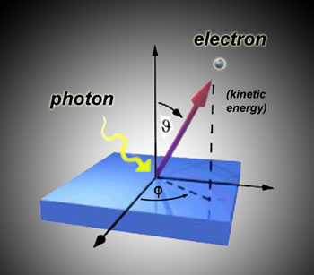
Topological insulators
Angle-resolved photo emission spectroscopy (ARPES)
Bi_{1-x}Sb_{x}
x = 0.12
x = 1.0
Hsieh et al., Nature (2008)
x = 0.10
Nishide, Taskin et al., PRB (2010)

Slide 12
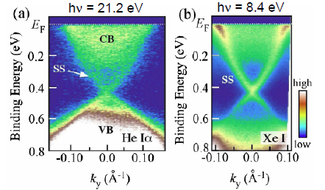
Topological insulators(2)
Bi₂Se₃
Bi₂Te₃
T.Sato et al., PRL (2010)
Bi₂Te₂Se
(Bi_{1-x}Sb_{x})₂(Te_{1-y}Se_{y})₃
Hsieh et al., Nature (2009)
Chen et al., Science (2009)
Pb(Bi_{1-x}Sb_{x})₂Te₄
…

Slide 13
Entanglement in quantum theories
Topological quantum phase
In actual studies
we need a mathematically rigid definition
we need a definition calculable from Hamiltonian

Slide 14



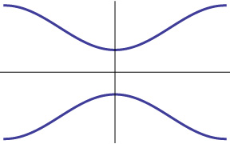






A mathematical definition of the entanglement is given by topological invariants
$$\left|\left.u(k)\right\rangle \right.$$
$$≈$$
wave function of occupied state
(a) entangled
(b) not entangled
$${(k}_{x}{,k}_{y})$$
$${(k}_{x}{,k}_{y})$$
(winding # 1)
(winding # 0)

Slide 15
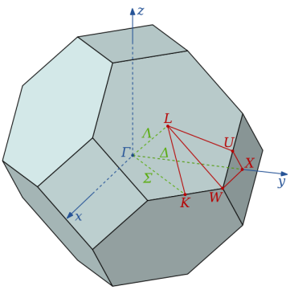

Mathematically, such a topological invariant can be defined by homotopy theory
homotopy
wave fn. of occupied state
$$\left|\left.u(k)\right\rangle \right.$$
Brillouin zone
(momentum space)
Hilbert space
We can also prove that gapless states exist on the boundary if the bulk topological # is nonzero (Bulk-boundary correspondence)
MS et al, Phys. Rev. B83 (2011) 224511

Slide 16



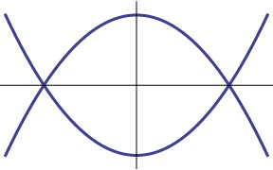
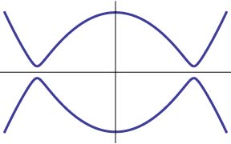
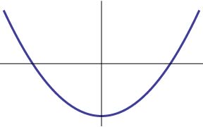



Topological surface states can appear also in superconductors
SC: Formation of Cooper pairs
$$≈$$
electron
Cooper pair
hole
In the ground state, states below the Fermi energy are fully occupied.

Slide 17




Like topological insulators, we can have a non-trivial entanglement (non-trivial topology) of occupied states
$$\left|\left.u(k)\right\rangle \right.$$
$$≈$$
Superconducting state with nontrivial topology
Topological Superconductors
Qi et al, PRB (09), Schnyder et al PRB (08),
MS, PRB 79, 094504 (09), MS-Fujimoto, PRB79, 214526 (09)

Slide 18
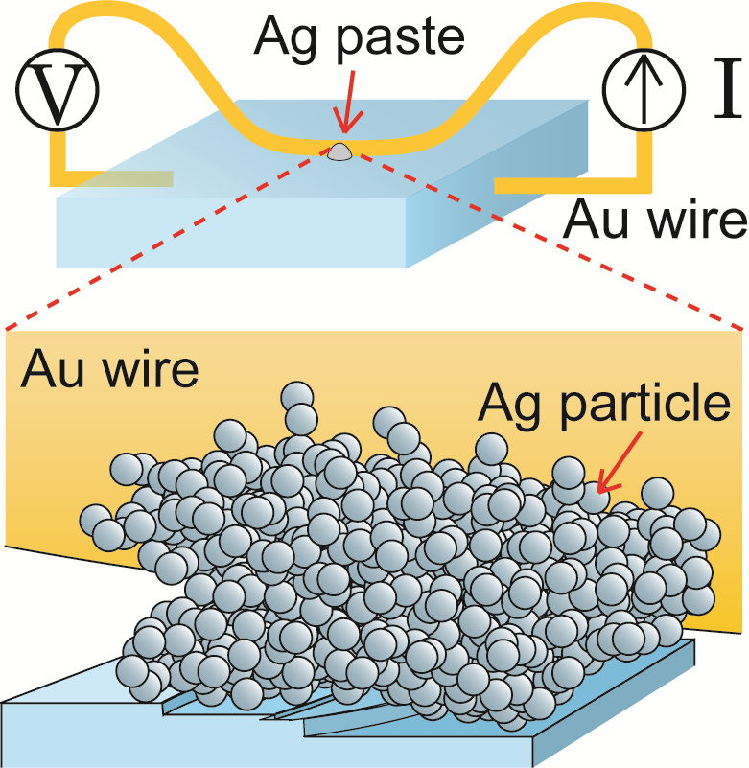
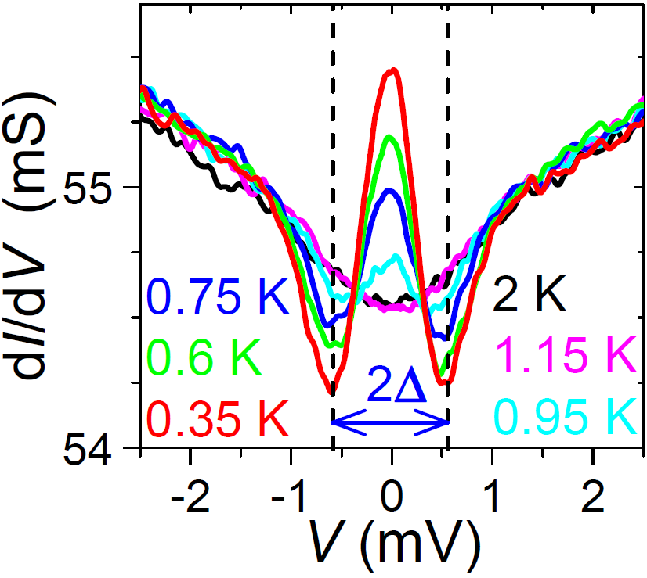
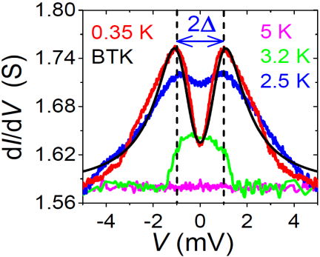
Surface gapless states in SCs can be detected by the tunneling conductance measurement.
[Sasaki, Kriener, Segawa, Yada, Tanaka, MS, Ando PRL (11)]
Cu_{x}Bi₂Se₃
Sn
Robust zero-bias peak appears in the tunneling conductance
Evidence of surface gapless modes

Slide 19
Summary (part 1)
There exist a class of phases that cannot be well-described by the Nambu-Landau theory. Such a class of phases are called as topological quantum phase.
One of characterizations of the topological phase is a non-trivial topological number of the occupied states. In this case, we have characteristic gapless states on the boundary.

Slide 20
Part 2. deconfinement as a topological phase

Slide 21
Question
Does any topologically entangled phase have gapless surface states?
No
We need a different method to study topological phase

Slide 22
Generally, a more direct way to examine the entanglement of the system is to use excitations
For example, by exchanging string-like excitations, we can examine the entanglement of the ground state, in a similar manner to examine the entanglement of muffler.
≈

Slide 23
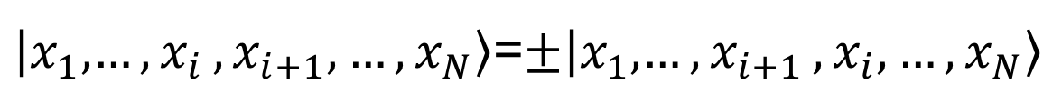
The entanglement depends on the statistics of excitations
If the system supports only bosonic or fermionic excitations, the ground state does not have the entanglement which is detectable by the braiding of excitations
$\left|x_{1},\right.\left.{…,x}_{i}, x_{i+1},…, x_{N}\right\rangle$=$±\left|x_{1},\right.\left.{…,x}_{i+1}, x_{i},…, x_{N}\right\rangle$
State goes back to the original by two successive exchange processes
No entanglement can happens

Slide 24
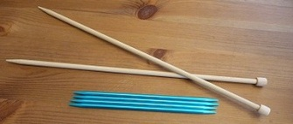


On the other hands, if there exist anyon excitation, the ground state should be entangled
Anyon
$\left|x_{1},\right.\left.{…,x}_{i}, x_{i+1},…, x_{N}\right\rangle$=$e^{iθ}\left|x_{1},\right.\left.{…,x}_{i+1}, x_{i},…, x_{N}\right\rangle$
$$θ≠0, π$$
Non-Abelian anyon
$e^{iθ}⟹U$
unitary matrix
Exchange of excitations may change states completely
$$\left\langle x_{1},…,x_{i+1},x_{i},…,x_{N} | x_{1},…,x_{i},x_{i+1},…,x_{N}\right\rangle =0$$
The ground state should be entangled

Slide 25
A stronger statement
In general, we can say that if we have a non-trivial Aharanov-Bohm phase by exchanging excitations, so we can expect the entanglement of the ground states.
Charge fractionalization is a manifestation of topological phases

Slide 26
Topological order in QCD
Idea
Charge fractionalization implies a topological order. And quarks have fractional charges
The quark deconfinement implies the topological order ?
yes
To examine the entanglement of the system, it is convenient to consider a topologically nontrivial base manifold.

Slide 27



Now we consider torus as a base manifold
3dim space with periodic boundary
3d torus
2dim case
2dim torus

Slide 28
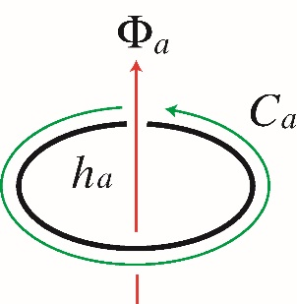

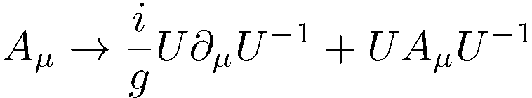

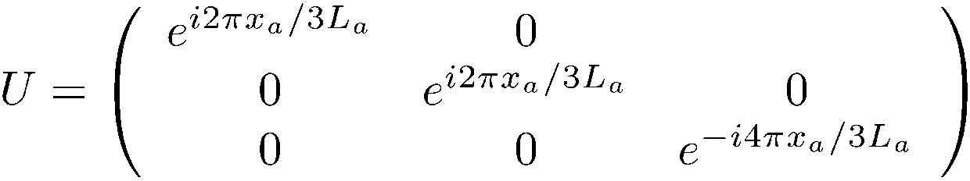
If the base manifold is torus, we have a new symmetry
Adiabatic electromagnetic flux insertion
through hole h_{a}
The spectrum is invariant after the flux insertion

Slide 29
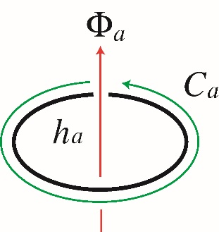
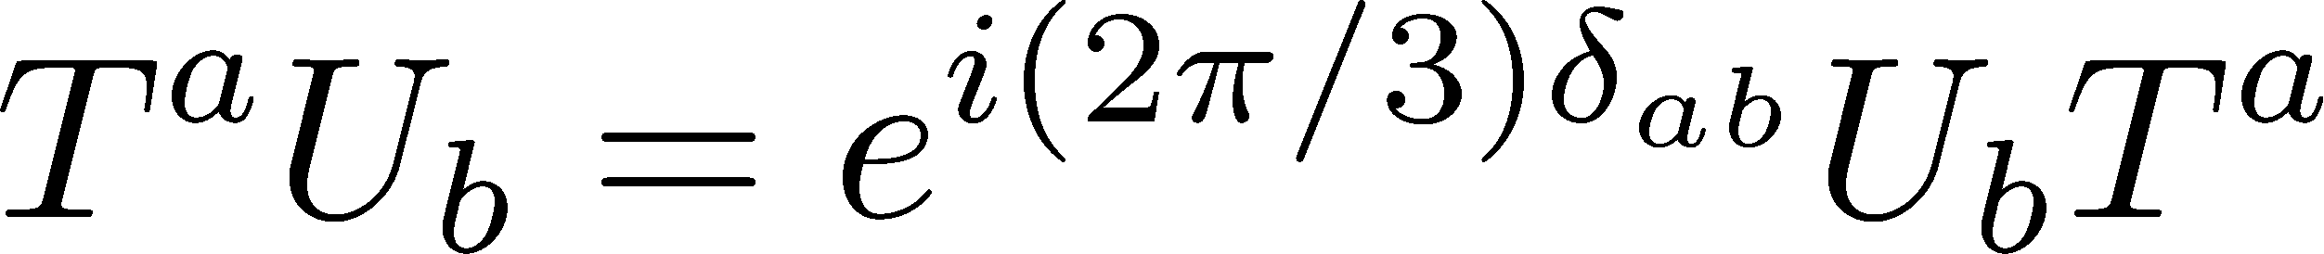


Interestingly, we have a non-trivial AB phase in the deconfinement phase
operator for the movement of quark around a-th circle of torus
Deconfiment phase is topologically ordered

Slide 30


On the other hand, we do not have such a nontrivial AB phase in the confinement phase
trivial
the movement of hadron or meson around a-th circle of torus
Confiment phase is topologically trivial

Slide 31
After all, we have the following algebra.
1) quark confinement phase
We only have commutative operators, and no new state is created by these operation
no entanglement
2) quark deconfiment phase
New states can be obtained by these operation
Entanglement

Slide 32
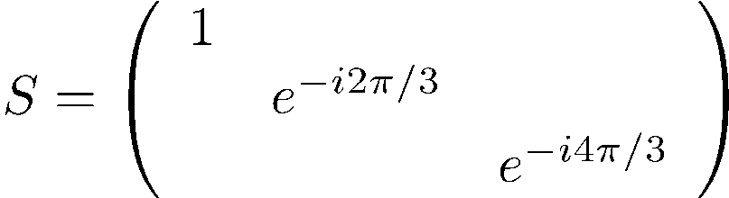
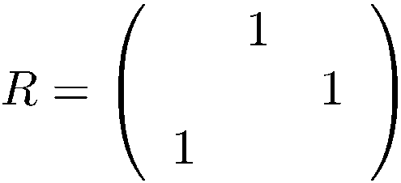
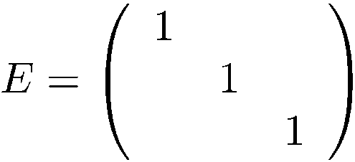



Degeneracy of ground states in the deconfinement phase = 3³

Slide 33
The confinement and deconfinement phases in QCD
are discriminated by the ground state degeneracy in the torus base manifold!
For SU(N) QCD on T^{n} ×R^{4-n}
deconfinement: N^{n} –fold ground state degeneracy
confinement: No such a topological degeneracy

Slide 34
To confirm the idea of topological order, I have performed the following consistency checks
comparison with the Wilson’s criteria in the heavy quark limit
perturbative calculation of the topological ground state degeneracy
consistency check with Fradkin-Shenker’s phase diagram
comparison with Witten index

Slide 35
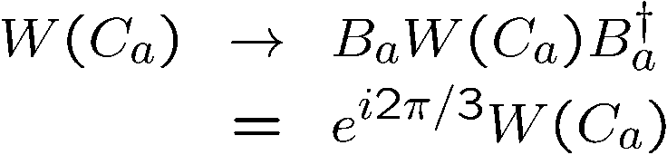

comparison with the Wilson’s criteria for quark confinement
QCD
SU(3) YM
heavy quark limit
The pure SU(3) YM has an additional symmetry known as
center symmetry
center symmetry
τ
link variable

Slide 36

confinement phase
area law
τ
In temporal gauge
cluster property
The center symmetry is not broken
No ground state degeneracy

Slide 37

deconfinement phase
perimeter law
breaking of the center symmetry
3³ degeneracy
The degeneracy reproduces our result

Slide 38
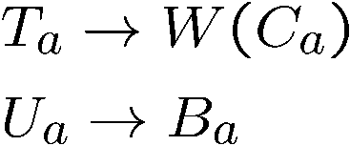
In the static limit, our condition for quark confinement coincides with the Wilson’s.
remark
In this limit, our algebra reproduces the ‘t Hooft algebra

Slide 39
3. comparison with Fradkin-Shenker’s phase diagram
Fradkin-Shenker’s result (79)
Higgs and the confinement phase are smoothly connected when
the Higgs fields transform like fundamental rep (complementarity).
They are separated by a phase boundary when the Higgs fields
transform like other than fundamental rep.
Our topological argument implies that no ground state degeneracy
exists when Higgs and the confinement phase are smoothly connected.

Slide 40

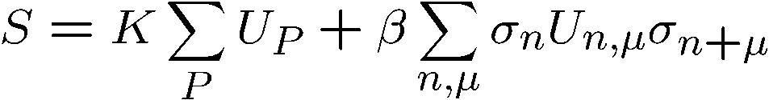

Z₂ gauge theory
Ising matter
Wilson loop
perimeter law
area law

Slide 41
Topological degeneracy
no ground state
degeneracy
2³ -fold degeneracy

Slide 42
Abelian Higgs model
1) Higgs charge =1
2) Higgs charge =2
perimeter law
area law

Slide 43

Our topological argument works when the Higgs field has the two unit of
charge.
charge 2
center symmetry
τ

Slide 44
Topological degeneracy
no ground state
degeneracy
2³ -fold degeneracy
massless
excitation

Slide 45
Summary
Generally, excitations can be used to examine the entanglement of the system directly.
If we have a non-trivial Aharanov-Bohm phase by exchanging excitations, we can expect the entanglement of the ground states
The concept of topological phase is useful to characteraize the quark confinement phase even in the presence of the dynamical quarks.

